Slide 1

Unstructured Finite-Volume Arbitrary Lagrangian / Eulerian Interface Tracking computational framework for incompressible two-phase flows with surfactants
Moritz Schwarzmeier¹, Suraj Raju¹, Zeljko Tukovic²,
Mathis Fricke¹, Dieter Bothe¹, Tomislav Maric¹
¹ Mathematical Modeling and Analysis, TU Darmstadt ² Faculty of Mechanical Engineering and Naval Architecture, FSB Zagreb
This presentation

Slide 2
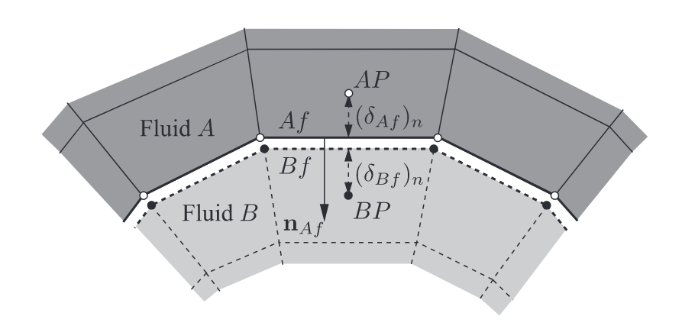
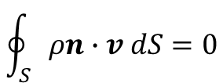


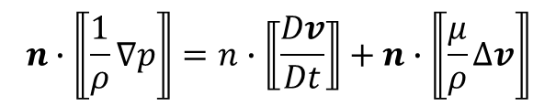
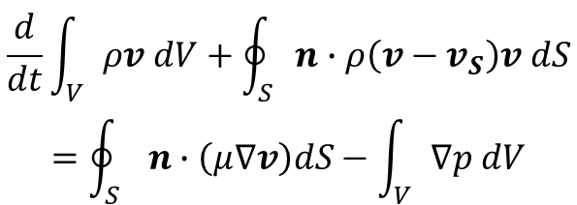
Interface-Tracking divides the domain with a sharp interface
Finite volume
Sharp interface
Moving mesh
Arbitrary cells
[Tuković and Jasak, 2012, p. 74]
Bulk equations
Interfacial jump conditions
$$\oint_{S}{ρn∙v dS=0}$$
$$⟦p⟧=−2⟦μ⟧∇_{S}∙v+σκ−2⟦ρg∙r⟧$$
$$⟦μ n∙ ∇v⟧=−∇_{S}σ−⟦μ\left(∇_{S}v\right)∙n⟧−⟦μ⟧n(∇_{S}∙v)$$
$$\frac{d}{dt}\int_{V}{ρv dV}+\oint_{S}{n∙ρ\left(v−v_{S}\right)v dS}$$
$$=\oint_{S}{n∙\left(μ∇v\right)dS−\int_{V}{∇p dV}}$$
$$⟦v⟧=0$$
$$n∙⟦\frac{1}{ρ}∇p⟧=n∙⟦\frac{Dv}{Dt}⟧+n∙⟦\frac{μ}{ρ}∆v⟧$$

Slide 3
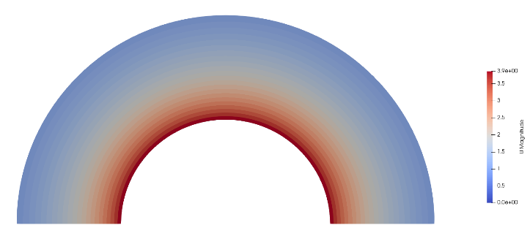
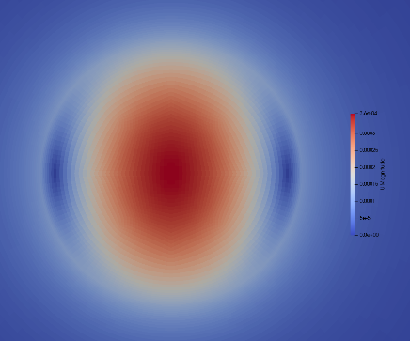
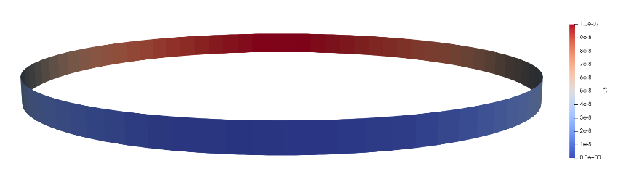
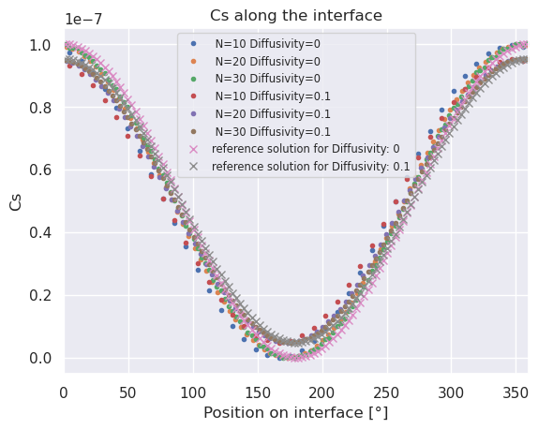
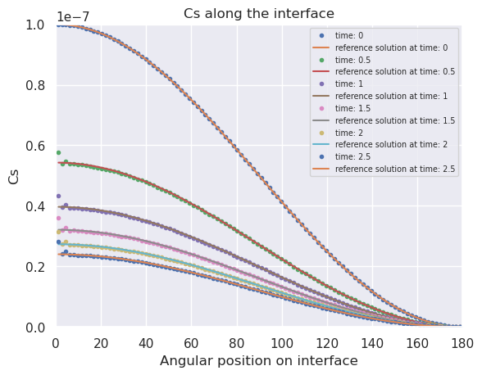
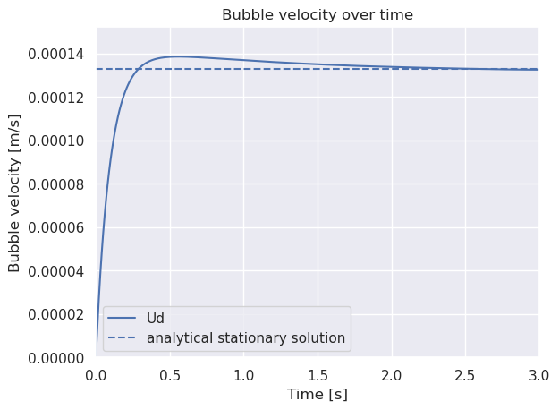
We verify surfactant capabilities
Transport with the interface
Changing interface
Surfactant induced Marangoni effect

Slide 4
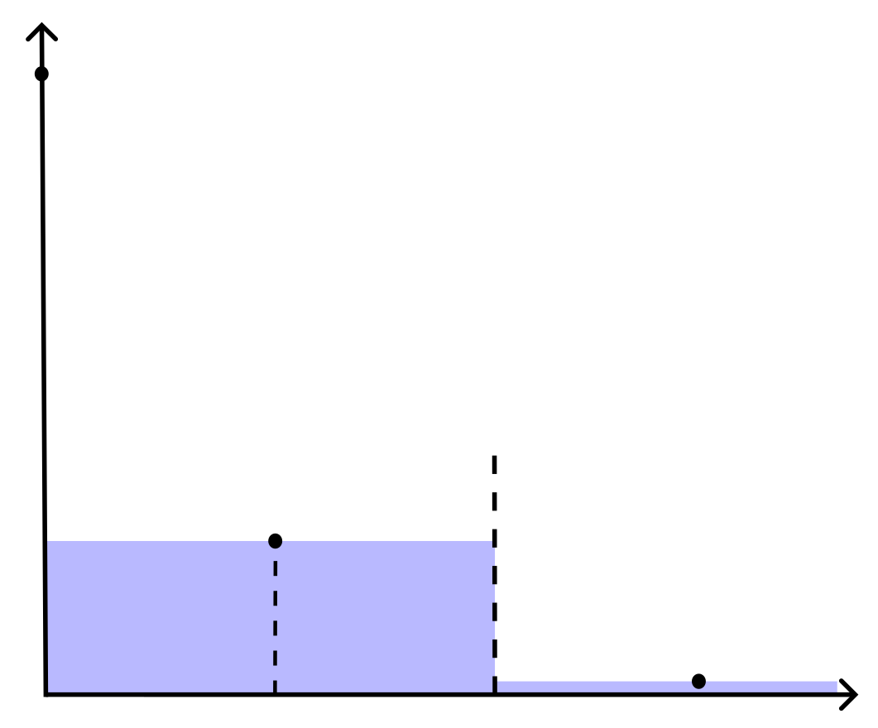
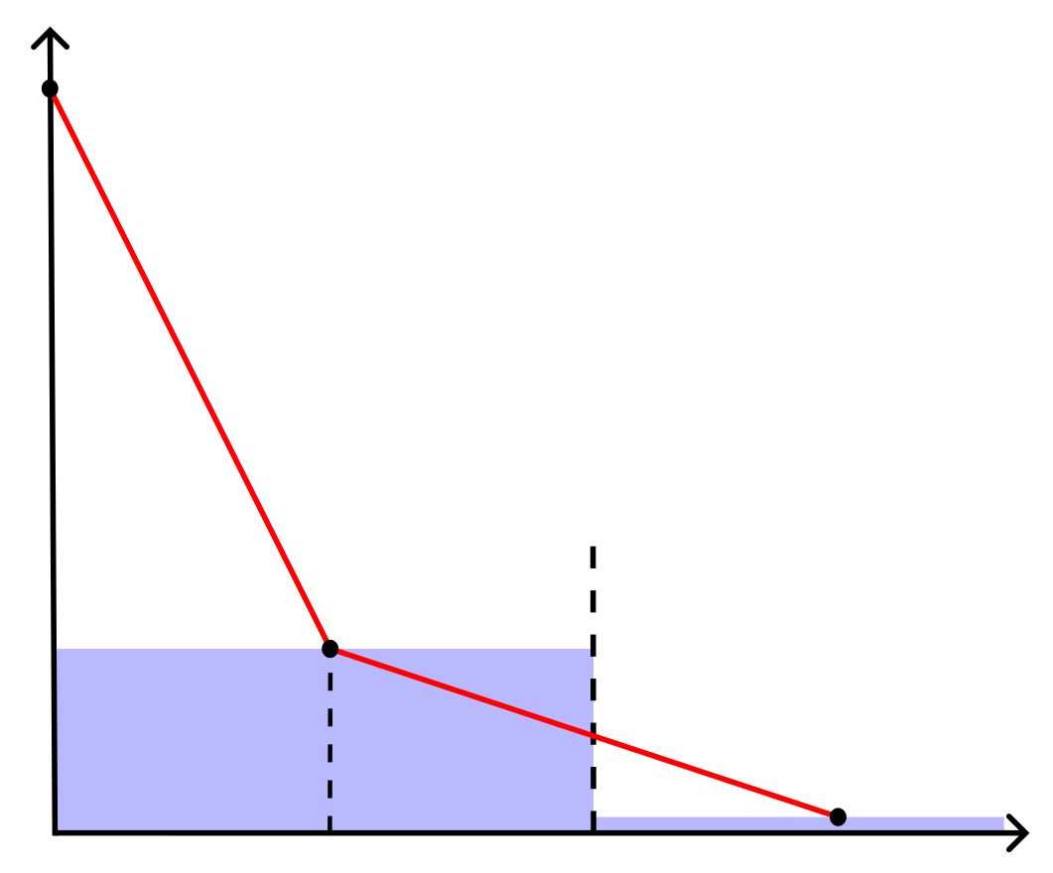
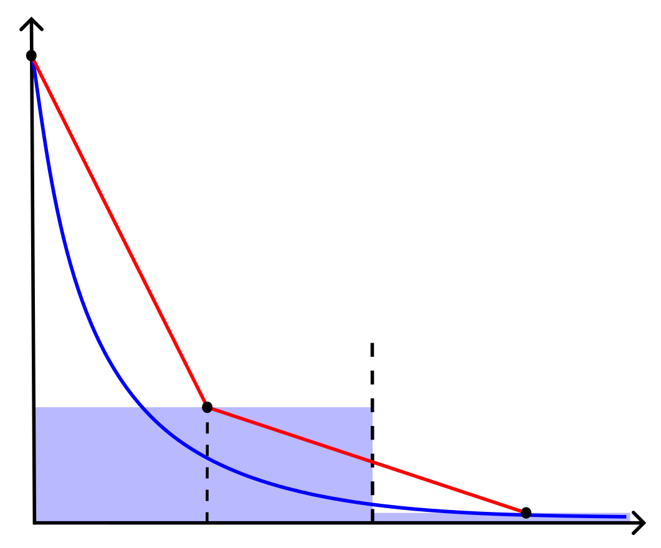
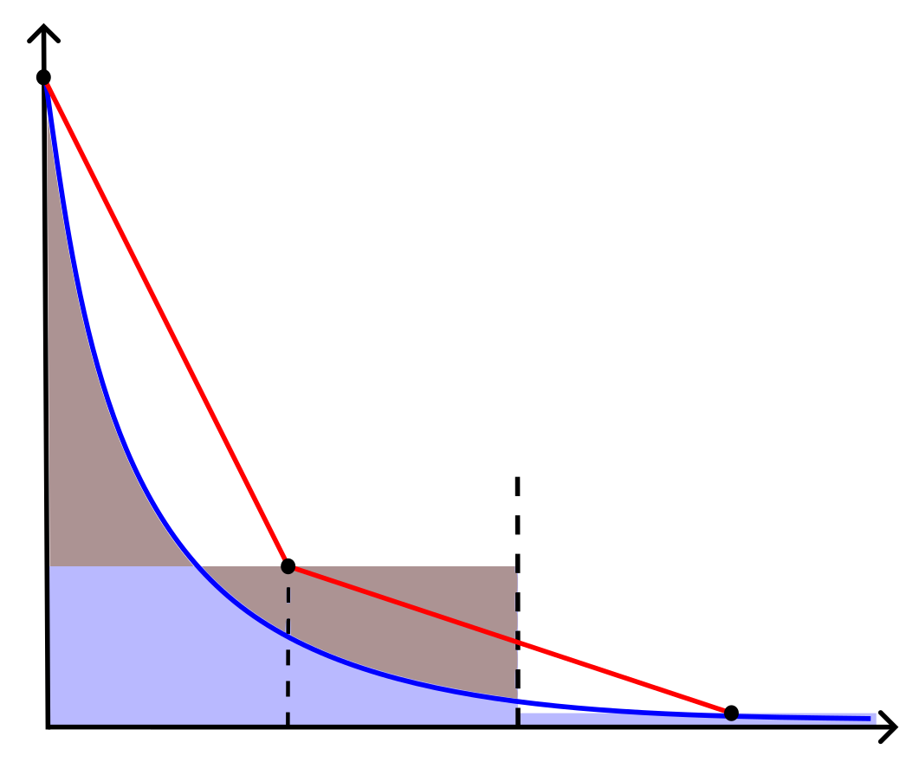
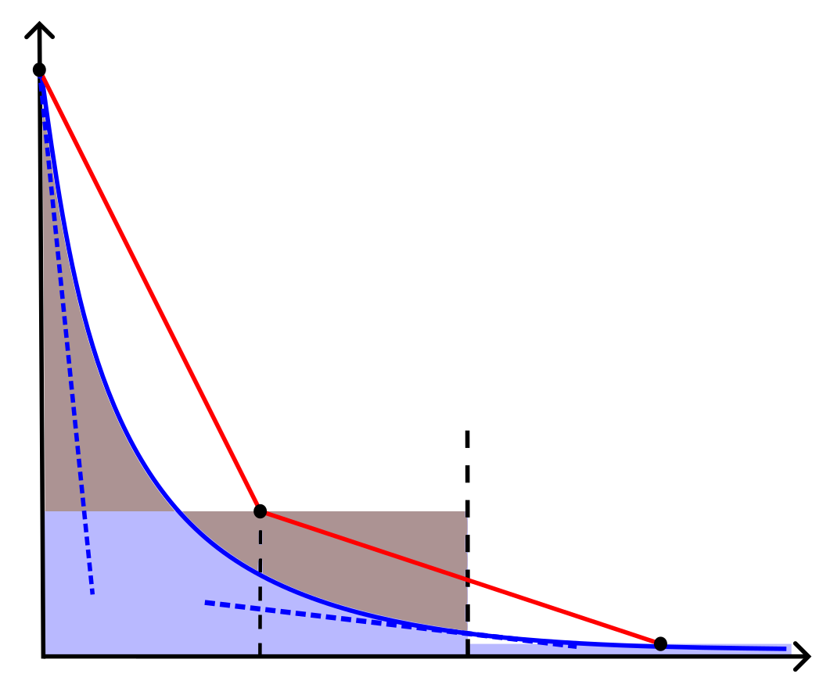
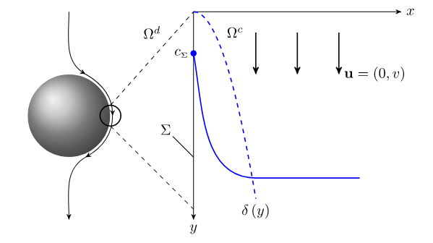
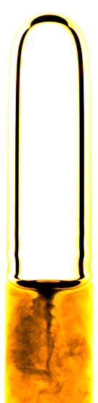





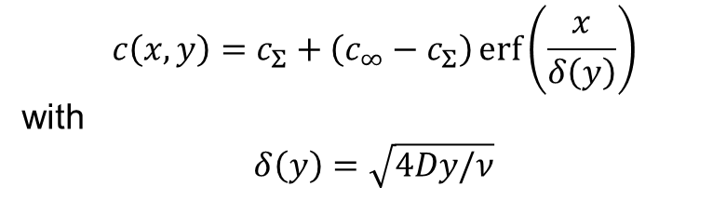


What is the SGS and why do we need it?
$$c\left(x\right)$$
$$c_{Σ}$$
Adaption of fluxes at both sides of the first boundary cell layer
$$x_{Σ}$$
$$x_{i}$$
$$x_{f}$$
$$x_{i+1}$$
$$x$$
$$c\left(x,y\right)=c_{Σ}+\left(c_{∞}−c_{Σ}\right)\operatorname{erf}\left(\frac{x}{δ\left(y\right)}\right)$$
with
$$δ\left(y\right)=\sqrt{4Dy/ν}$$
Reactive Oxygen Taylor Bubble - Solution of Cu(btmgp)I (20 mM) in Acetonitrile at ambient pressure and temperature. Source: Project Group Prof. Dr.-Ing. Michael Schlüter, TU Hamburg: Experimental Investigation of Reactive Bubbly Flows - Influence of Boundary Layer Dynamics on Mass Transfer and Chemical Reactions

Slide 5
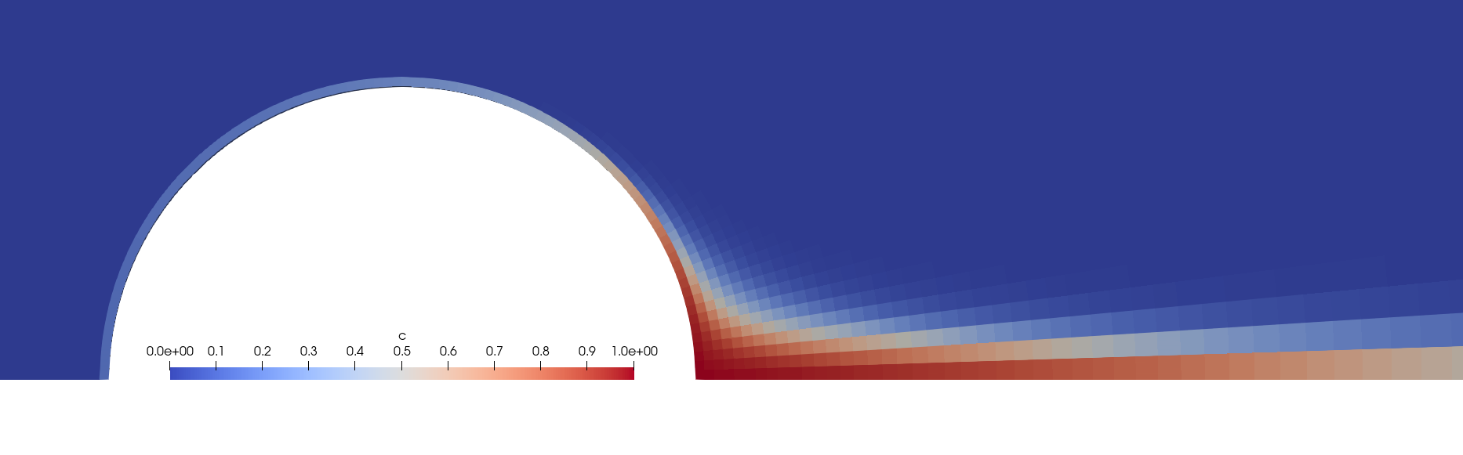
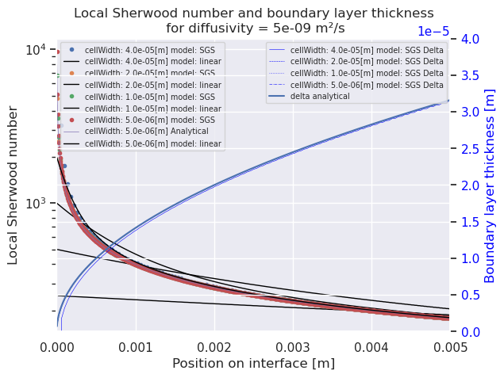
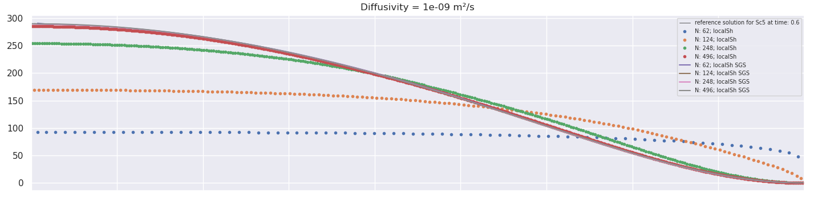
For development we have simple test cases
Flat plate
Axisymmetric bubble
Sherwood number
Position on interface

Slide 6
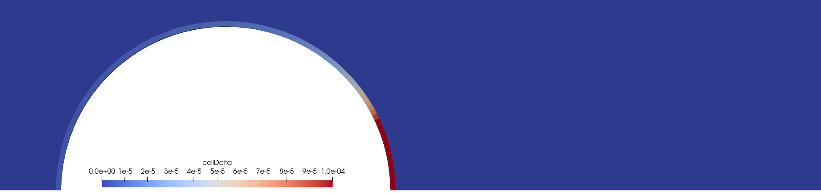
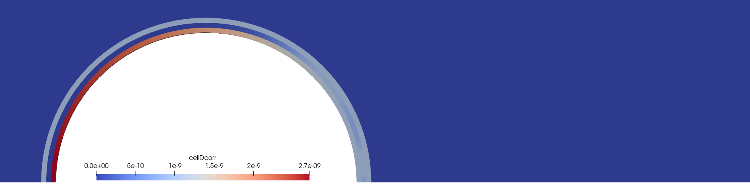
We added extensive evaluation possibilities, e.g.
Concentration
The concentration boundary layer is embedded into the first layer of cells adjacent to the interface over a large portion of the bubble.
Boundary layer thickness
The boundary layer thickness grows slowly, where the flow is adjacent. It is big, where the flow is separated.
Diffusivity coefficient (from inside out: at the interface, the 2nd layer, original)
In the impingement area, the flow at the interface is increased, but decreased at the cell faces between first and second cell layer. Not much correction is needed where the boundary layer thickness is big.

Slide 7

Wrap-up
We provide an Arbitrary Lagrangian/Eulerian Interface Tracking (ALE-IT) framework for OpenFOAM
We implemented our Subgrid-scale model library
Calculate very thin passive scalar boundary layers
Correct diffusive and convective fluxes at the boundary and the faces next to the interface
The fluxes at the interface are increased
The fluxes at the faces next to the interface are decreased
Visualisation of Subgrid-scale model internal parameters enables understanding and further developments
Publicly available soon

Slide 8


Further reading
This presentation DOI: 10.48328/tudatalib-1266.5
Preprint (currently in preparation)
Code repository (currently private, going public soon) https://gitlab.com/interface-tracking/
Papers
Interface Tracking: Zeljko
Tuković, Ž. & Jasak, H. A moving mesh finite volume interface tracking method for surface tension dominated interfacial fluid flow. Computers & Fluids 55, 70–84 (2012).
Subgrid-scale model
Pesci, C., Weiner, A., Marschall, H. & Bothe, D. Computational analysis of single rising bubbles influenced by soluble surfactant. J. Fluid Mech. 856, 709–763 (2018).
Weiner, A. & Bothe, D. Advanced subgrid-scale modeling for convection-dominated species transport at fluid interfaces with application to mass transfer from rising bubbles. Journal of Computational Physics 347, 261–289 (2017).
Surfactant verification cases
Antritter, T. Numerical Simulation of Coupled Wetting and Transport Phenomena in Inkjet Printing. (Technische Universität Darmstadt, 2022). doi:10.26083/tuprints-00021326.
This presentation
Code repository is coming for Christmas

Slide 9
Appendix

Slide 10
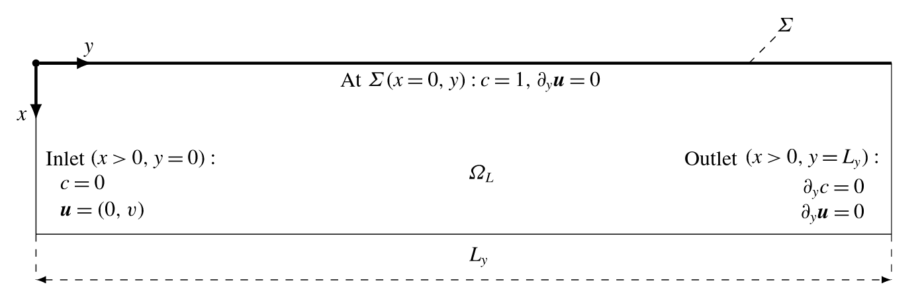

Flat plate
Prescribed velocity = 0.1 m/s
No velocity boundary layer
Peclet number 10⁵
Tested with 10⁴ – 10⁷
$$Pe=\frac{L∙u}{D}$$

Slide 11
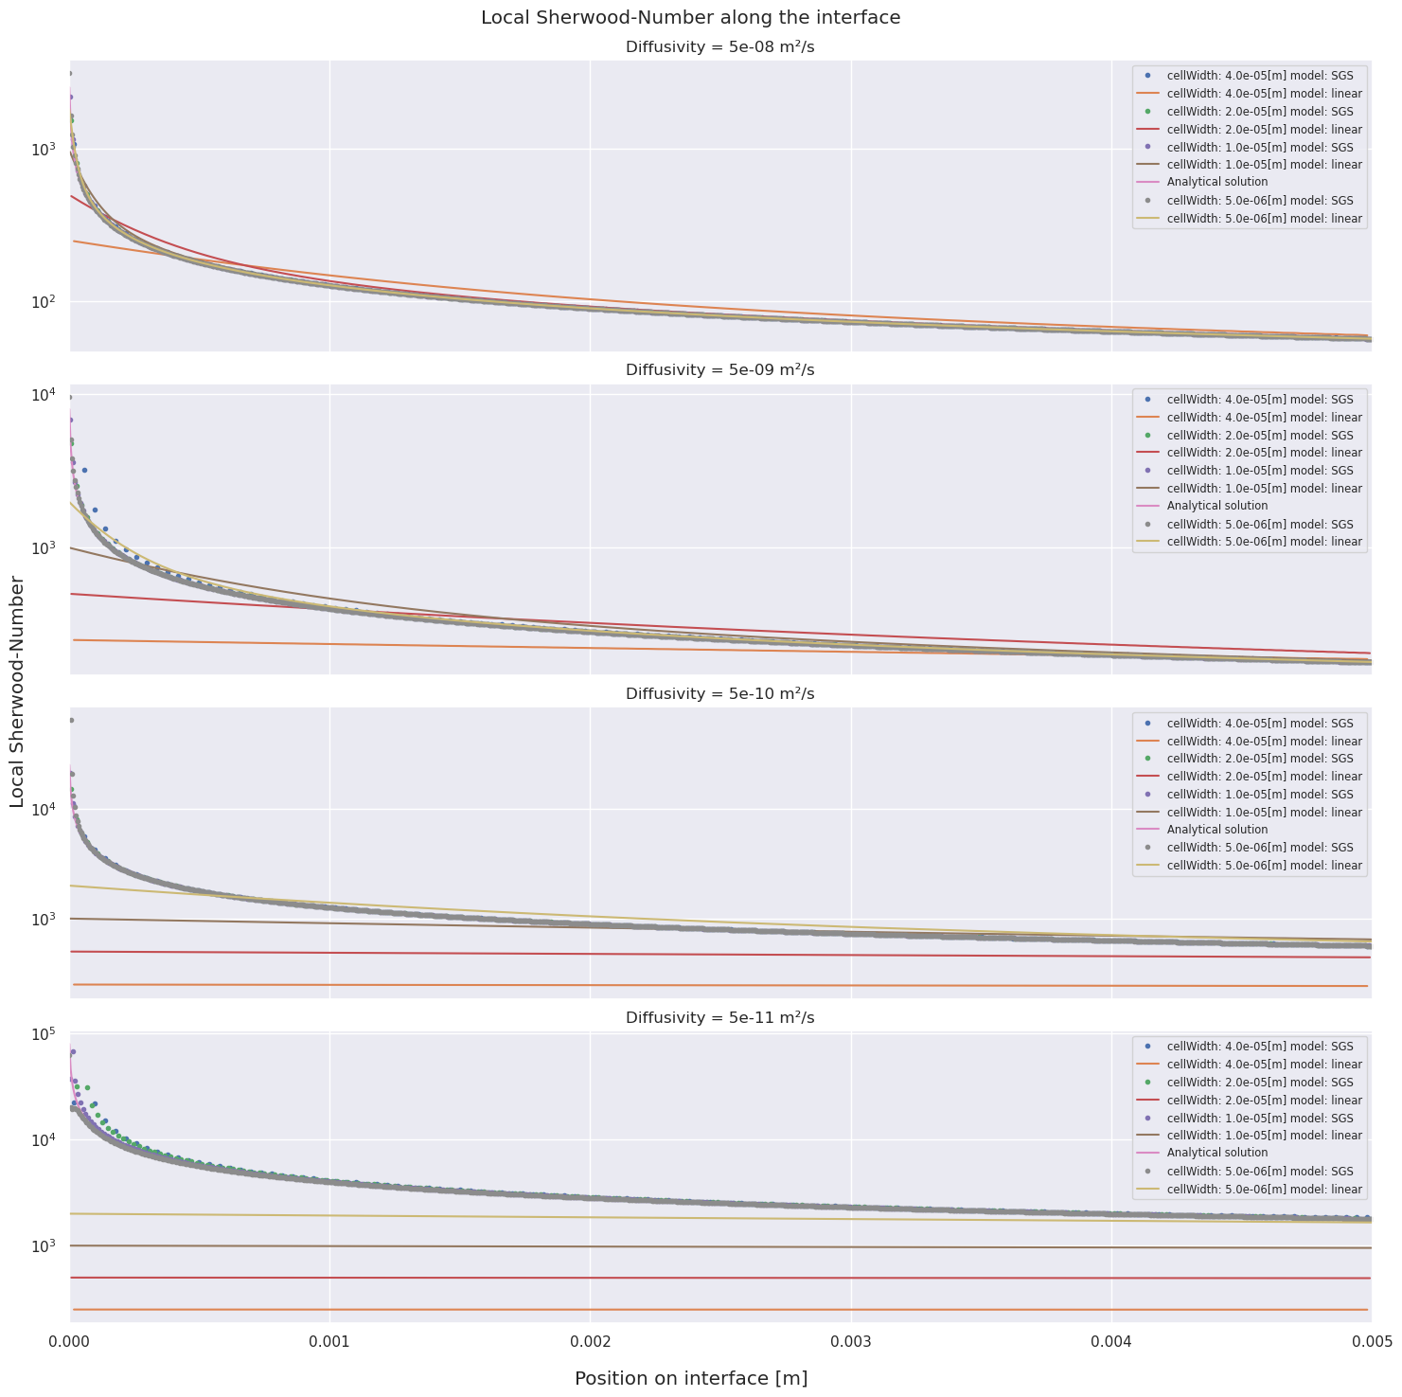
Flat plate
Diffusivity [m²/s] | Peclet number [ ]
5e⁻⁰⁸ | 1e⁴
5e⁻⁰⁹ | 1e⁵
5e⁻¹⁰ | 1e⁶
5e⁻¹¹ | 1e⁷

Slide 12
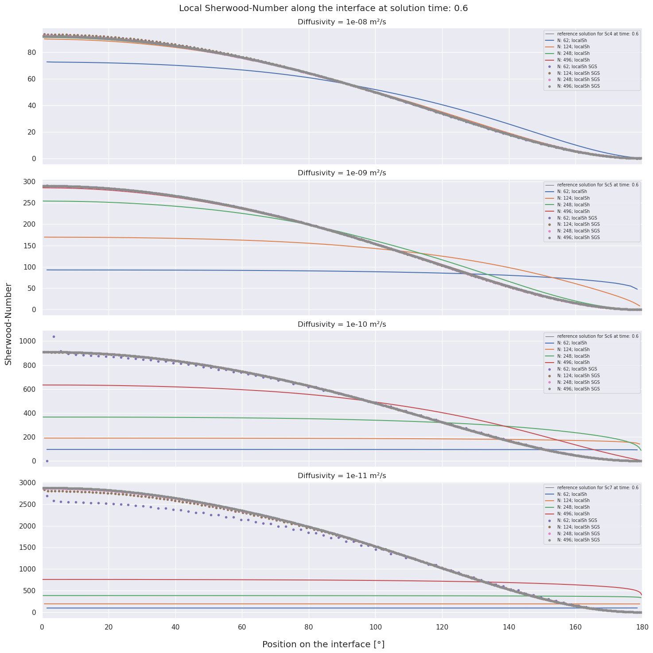
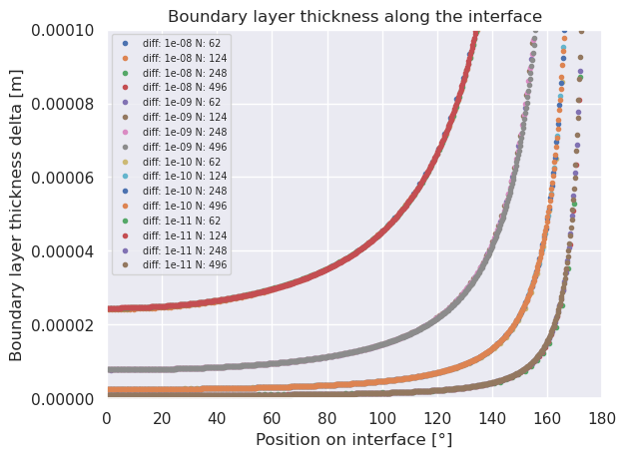

Axisymmetric bubble
Prescribed velocity based on solution by Satapathy & Smith
Spherical bubble (Ø 2mm) with rigid interface
Axisymmetric setup
Schmidt-numbers of real-world problems
$$Sc=\frac{μ}{D}$$
Diffusivity [m²/s] | Schmidt number [ ]
5e⁻⁰⁸ | 1e⁴
5e⁻⁰⁹ | 1e⁵
5e⁻¹⁰ | 1e⁶
5e⁻¹¹ | 1e⁷

Slide 13

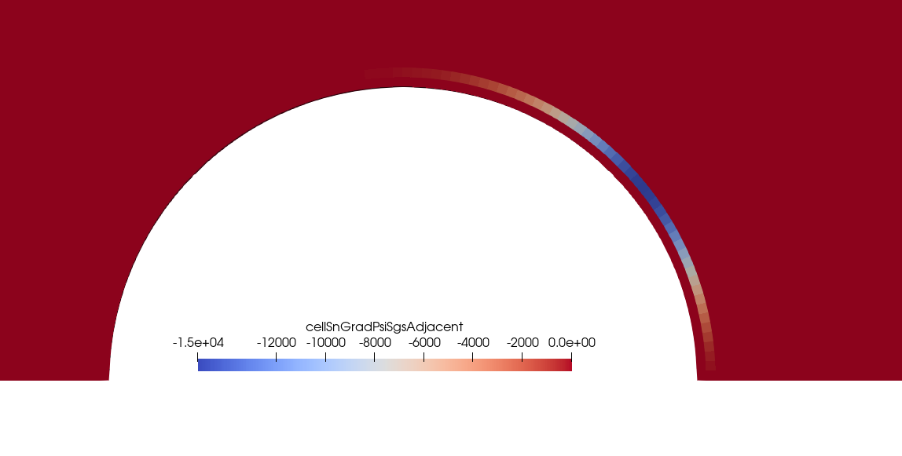
Axisymmetric bubble
Concentration
Surface normal gradient at the surface
Surface normal gradient at outward-faces of the 1st cell layer
Accumulates pronounced in the wake of the bubble.
Decreases over the run length to almost zero in the wake.
Is highest where the flow is still adjacent. Is almost zero in the impingement area and in the center of the wake.

Slide 14
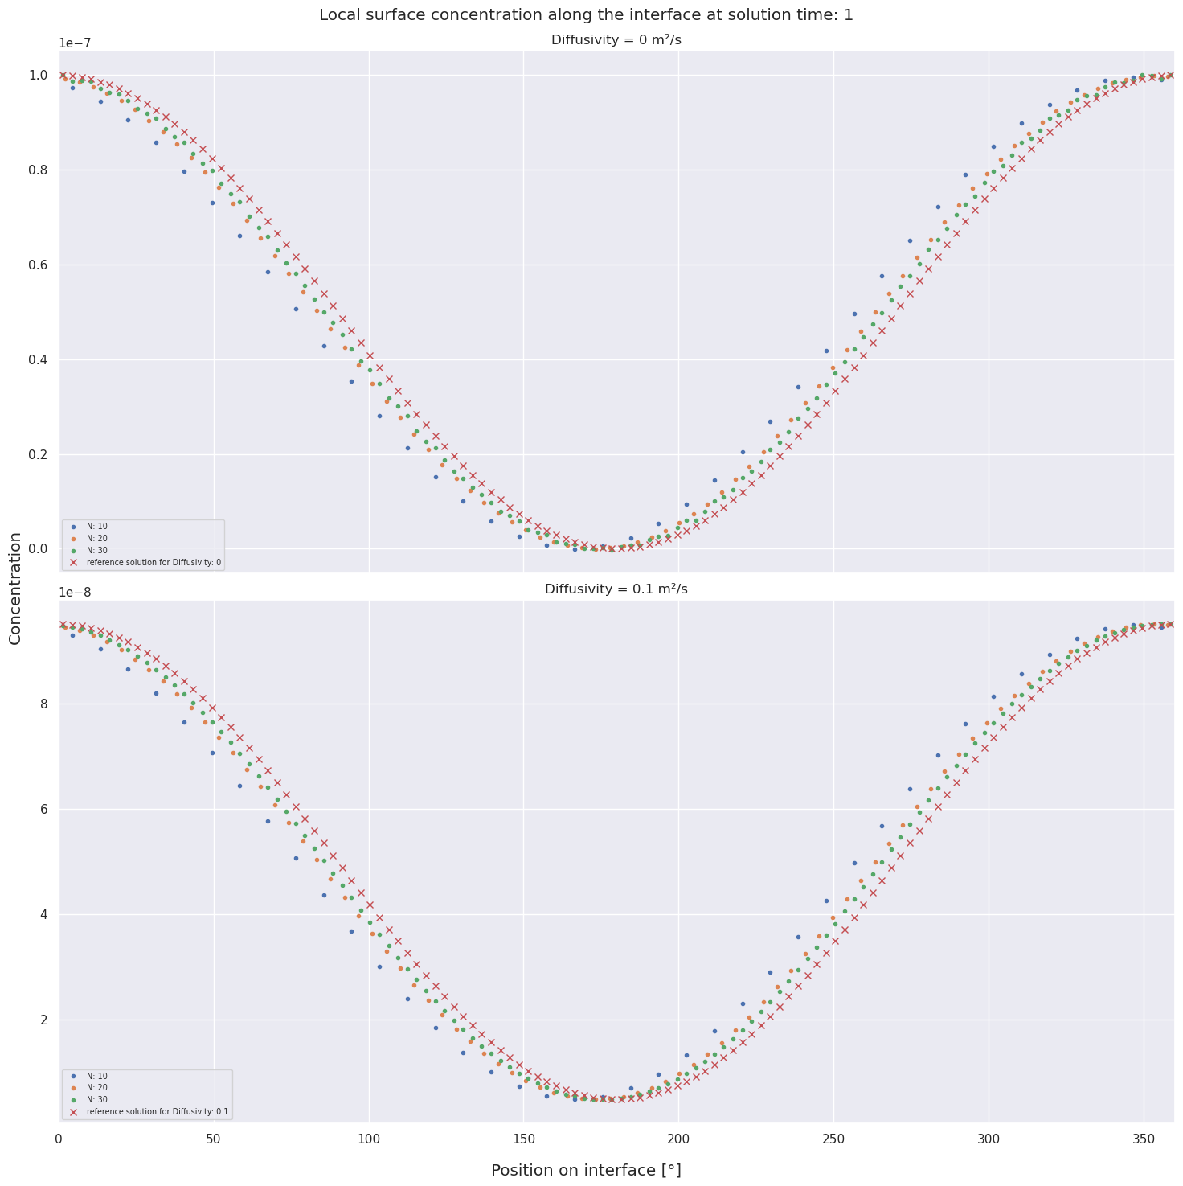
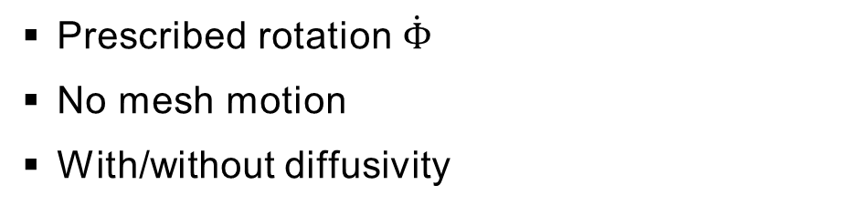


Rotating contaminated droplet
$$\dot{Φ}$$
$$Γ(Φ,τ)=\frac{e^{−D∗r_{0}^{−2}τ}\cos\left(Φ−\dot{Φ}τ\right)+1}{2}Γ_{0}$$
cf. [Antritter, 2022]
Prescribed rotation $\dot{Φ}$
No mesh motion
With/without diffusivity

Slide 15
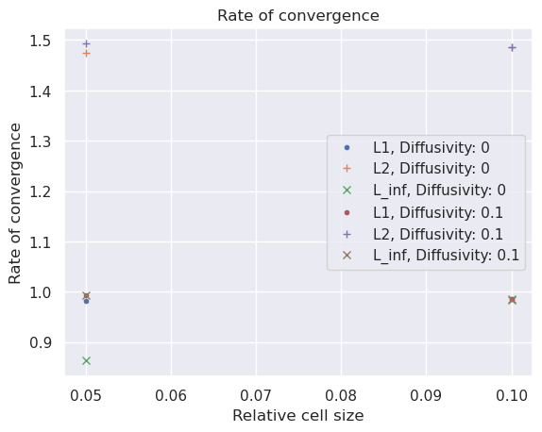
Rotating contaminated droplet
$$\dot{Φ}$$
$$Γ(Φ,τ)=\frac{e^{−D∗r_{0}^{−2}τ}\cos\left(Φ−\dot{Φ}τ\right)+1}{2}Γ_{0}$$
cf. [Antritter, 2022]
Prescribed rotation $\dot{Φ}$
No mesh motion
With/without diffusivity

Slide 16
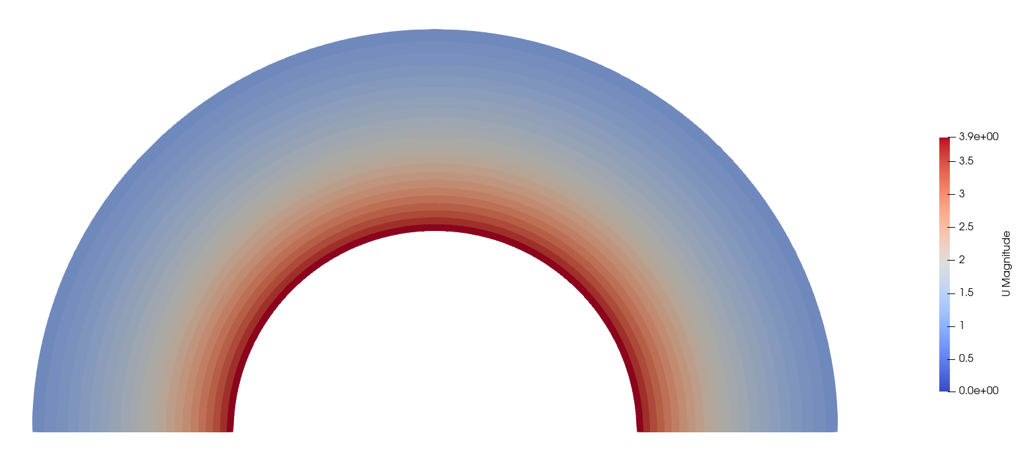
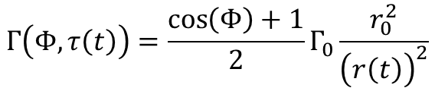
Expanding contaminated droplet
$$Γ\left(Φ,τ\left(t\right)\right)=\frac{\cos\left(Φ\right)+1}{2}Γ_{0}\frac{r_{0}^{2}}{{\left(r\left(t\right)\right)}^{2}}$$
cf. [Antritter, 2022]
Prescribed velocity
Prescribed mesh motion
No diffusion

Slide 17
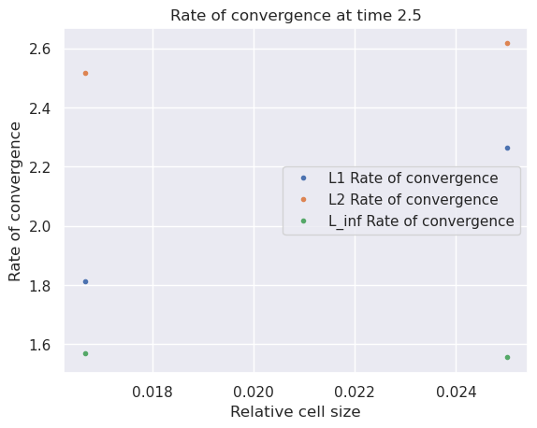
Expanding contaminated droplet
$$Γ\left(Φ,τ\left(t\right)\right)=\frac{\cos\left(Φ\right)+1}{2}Γ_{0}\frac{r_{0}^{2}}{{\left(r\left(t\right)\right)}^{2}}$$
Prescribed velocity
Prescribed mesh motion
No diffusion
cf. [Antritter, 2022]

Slide 18
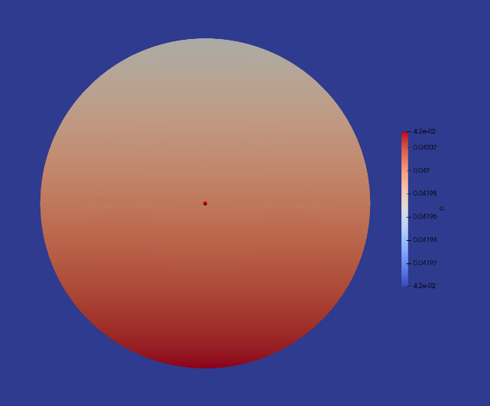
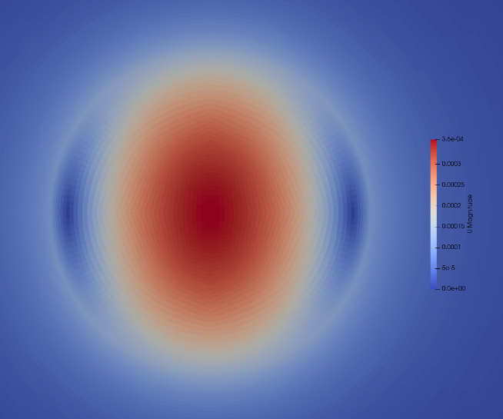
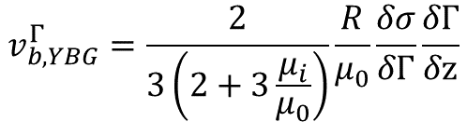
Surfactant induced Marangoni effect driven bubble
$$v_{b,YBG}^{Γ}=\frac{2}{3\left(2+3\frac{μ_{i}}{μ_{0}}\right)}\frac{R}{μ_{0}}\frac{δσ}{δΓ}\frac{δΓ}{δz}$$
No (mesh) motion, rigid bubble
Fixed surfactant concentration leads to pressure gradient

