Slide 1
Surface-Plasmon- and Green-Light-Induced Polymerization in Mesoporous Thin Silica Films
Daniel John, Reza Mohammadi, Nicolas Vogel, and Annette Andrieu-Brunsen
https://dx.doi.org/10.1021/acs.langmuir.0c00043
Public Data

Slide 2
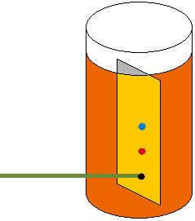
a)
b)
Si-O-H
C=O
Green laser
532 nm
10 mm distance
5 mm distance
Laser focussed spot
Figure 1 – original

Slide 3
a)
b)
C=O
Si-O-H
Green laser
532 nm
10 mm distance
5 mm distance
Laser focussed spot
Figure 1 – TIFF

Slide 4
Threshold power not overcome
a)
Figure 2 – Original
b)
c)
0.3 mW
18.4 mW

Slide 5
Threshold power not overcome
a)
Figure 2 – TIFF
b)
c)
0.3 mW
18.4 mW

Slide 6
Figure 4: Polymerizations at plasmon beginning
a)
b)
c)

Slide 7
Figure 4: Polymerizations at plasmon beginning – TIFF + SEM – Figure 4 a refit, Figure 4 b suited
a)
b)
c)
d)
e)

