Slide 1
Influence of Nanoconfinement on the pKa of Polyelectrolyte Functionalized Silica Mesopores
Robert Brilmayer, Sonja Kübelbeck, Adnan Khalil, Martin Brodrecht, Ulrike Kunz, Hans-Joachim Kleebe, Gerd Buntkowsky, Grit Baier, and Annette Andrieu-Brunsen
https://doi.org/10.1002/admi.201901914
Public Data

Slide 2
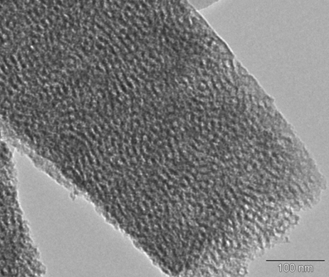
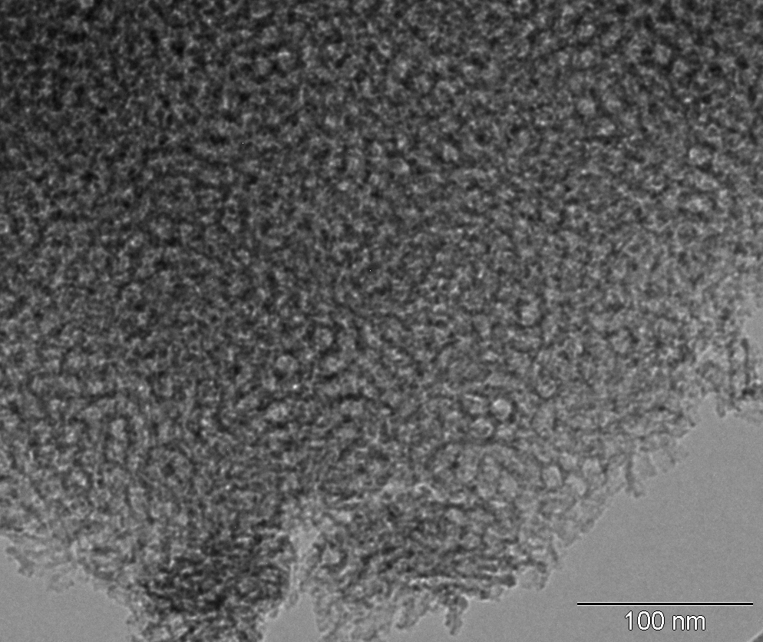
SP
BP
3 nm
12 nm
200 nm
500 nm
8 nm
16 nm
100 nm
100 nm
MEP
DMAEMA
Irradiation 365 nm
SBDC
Figure 1

Slide 3
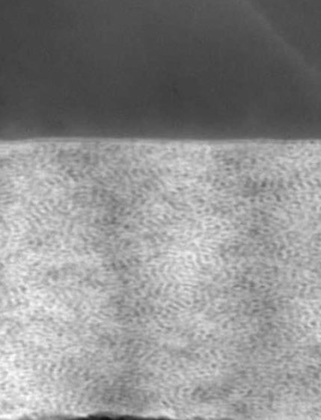
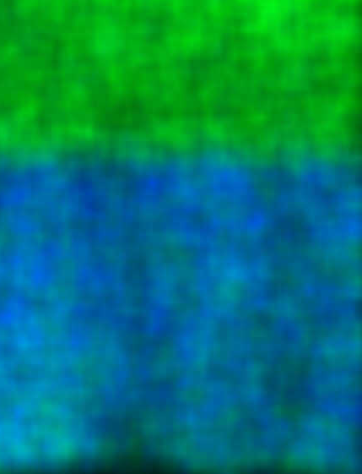
a)
b)
200 nm
200 nm
substrate
substrate
c)
d)
Figure 2

Slide 4

b)
a)
+
+
+
+
+
+
ΔpH
charge transition
c)
electrode
electrode
ΔpKa
acidic pH basic
pKa1 MEP bulk
pKa2 MEP bulk
Figure 3

Slide 5
-
-
a)
-
b)
pH 1.8
pH 10.4
-
-
-
+
+
+
+
+
ΔpH
charge transition
+
+
+
+
c)
d)
electrode
electrode
acidic pH basic
Figure 4

Slide 6
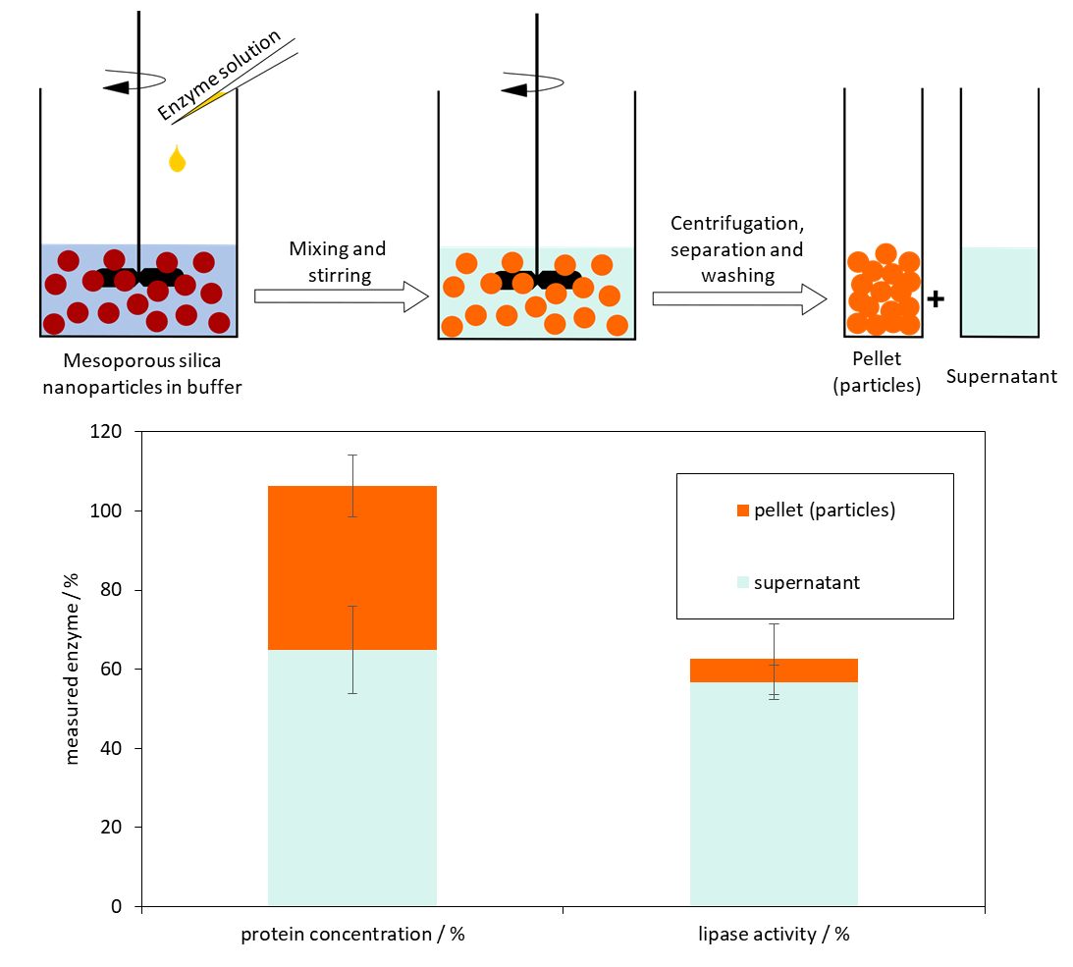
Figure 5

Slide 7
SI

Slide 8
Figure S1

Slide 9
a)
b)
Figure S2

Slide 10
a)
b)
Figure S3

Slide 11
Figure S4

Slide 12
Model Boltzmann
Equation y = A2 + (A1-A2)/(1 + exp((x-x0)/dx))
Reduced Chi-Sqr 9,18158
Adj. R-Square 0,99813
Value Standard Error
A1 97,37277 1,76524
A2 241,31189 1,8439
x0 6,67668 0,02612
dx 0,25181 0,02321
span 143,93913 2,58193
EC50 793,6803 20,73184
Figure S5

Slide 13
Figure S6

Slide 14
Figure S7

Slide 15
Figure S8

Slide 16
Figure S9

Slide 17
Figure S10

Slide 18
Figure S11

Slide 19
Figure S12

Slide 20
Figure S13

Slide 21
SP films 1.5 % vs 4.1 % c=O signal
Pka 7.9 vs 7.6
BP films 4.9 % vs 15.7 % C=O signal
Pka 7.3 vs 7.5
a)
b)
c)
Figure S14. Comparison of j_{p} values plotted against the solution pH of a) Figure S8 and S10, b) Figure S9 and S13, c) Figure S12 and S13.
BP films 4.9 % vs 15.7 % C=O signal
Pka 7.3 vs 7.5

Slide 22
Figure S15

Slide 23
Figure S17: SEM images of TEOS-ODMS nanoparticles (a) as well as TEOS nanoparticles after calcination (b). In both cases the particle size varies between ~80 – 100 nm.

Slide 24
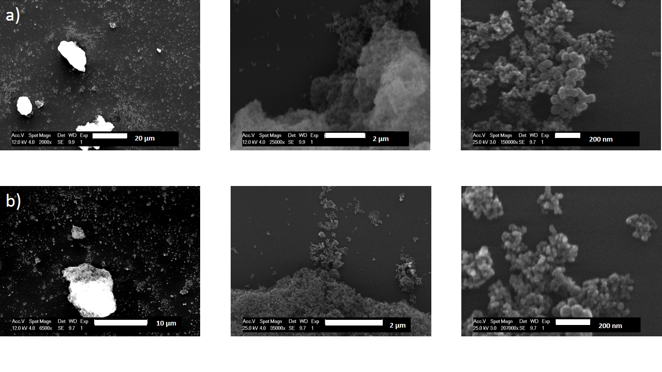
Figure S18: SEM images of BTSE-ODMS nanoparticles (a) as well as BTSE nanoparticles after calcination (b). In both cases the particle size varies between ~30 – 100 nm.
To show the succesfull template removal N₂-BET measurements were performed to determine the pore volume and the specific surface area.

Slide 25
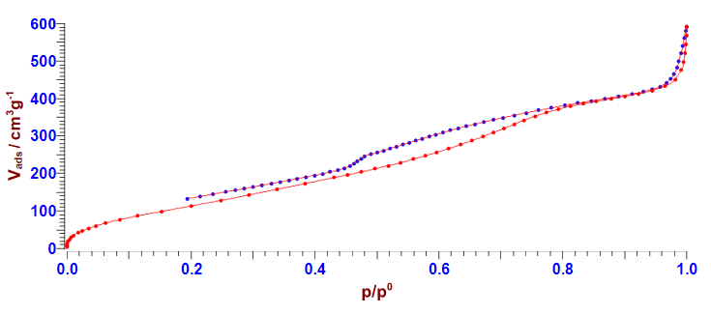
Figure S19: Adsorption isotherm of TEOS-ODMS nanoparticles.
With a sample mass of 0.2119 g, the measured pore volume (Gurvich) at p/p0 0.95 is 0.6555 cm³g⁻¹ and the surface area at p/p⁰ 0.1 to 0.4 was determined to be 518.79 m²g⁻¹ ± 5.81117.

Slide 26
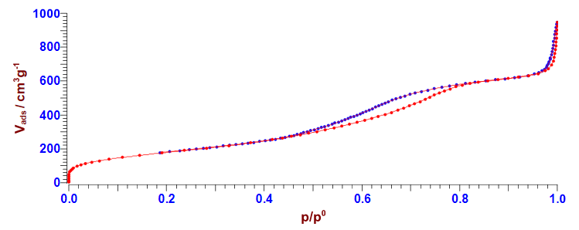
Figure S20: Adsorption isotherm of TEOS nanoparticles after calcination.
With a sample mass of 0.2283 g, the measured pore volume (Gurvich) at p/p0 0.95 is 0.9836 cm³g⁻¹ and the surface area at p/p⁰ 0.05 to 0.5 was determined to be 659.49 m²g⁻¹ ± 1.39782.

Slide 27
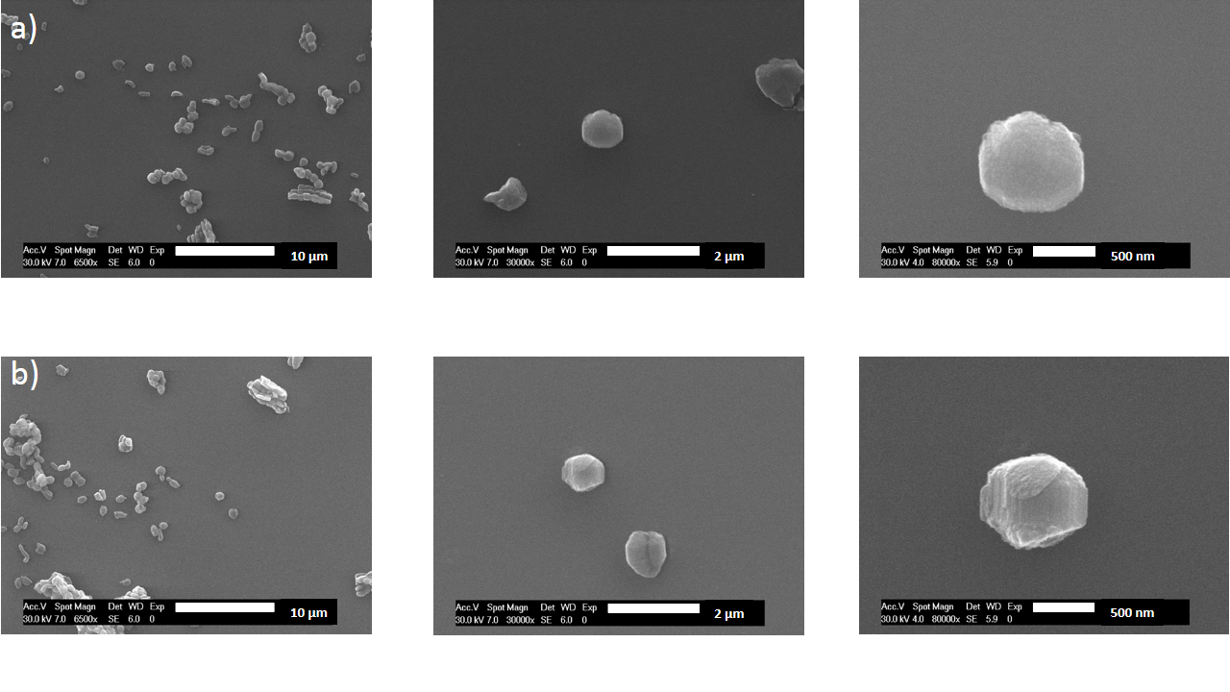
Figure S21: SEM images of SBA-15 material before (a) and after amine functionalization (b). In both cases the particle size varies between ~800 – 900 nm.

