Slide 1
Wettability-defined droplet imbibition in ceramic mesopores
Adnan Khalil, Felix Schäfer, Niels Postulka, Mathias Stanzel, Markus Biesalski and Annette Andrieu-Brunsen
https://dx.doi.org/10.1039/d0nr06650h
Public Data

Slide 2
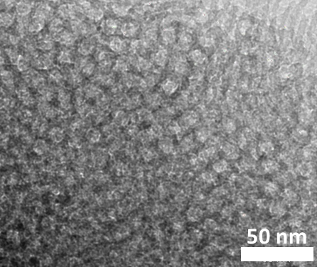
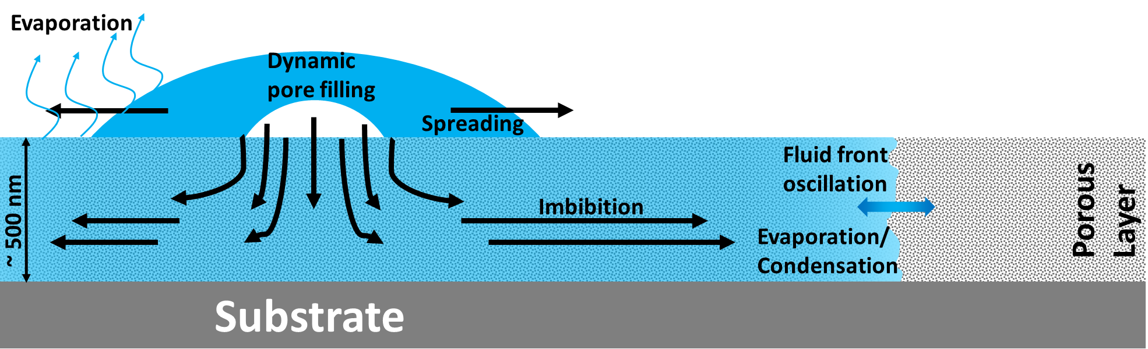

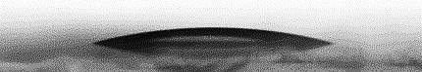
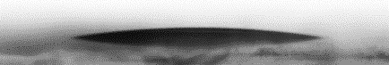
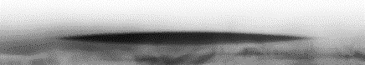
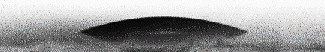
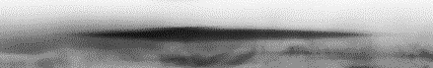
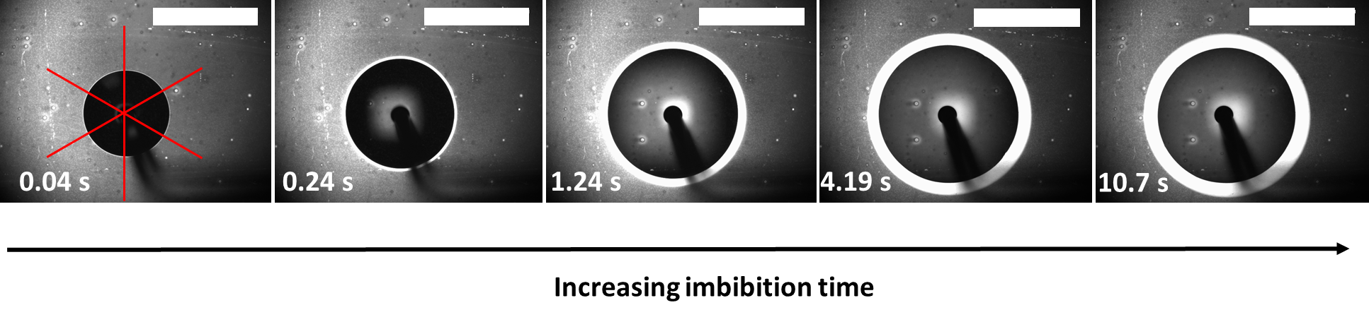

Figure 1
a)
50 nm
Wetting dependent imbibition distance
TEM-
Topview
b)

Slide 3
Figure 2

Slide 4
Figure 3

Slide 5
Figure 4

Slide 6
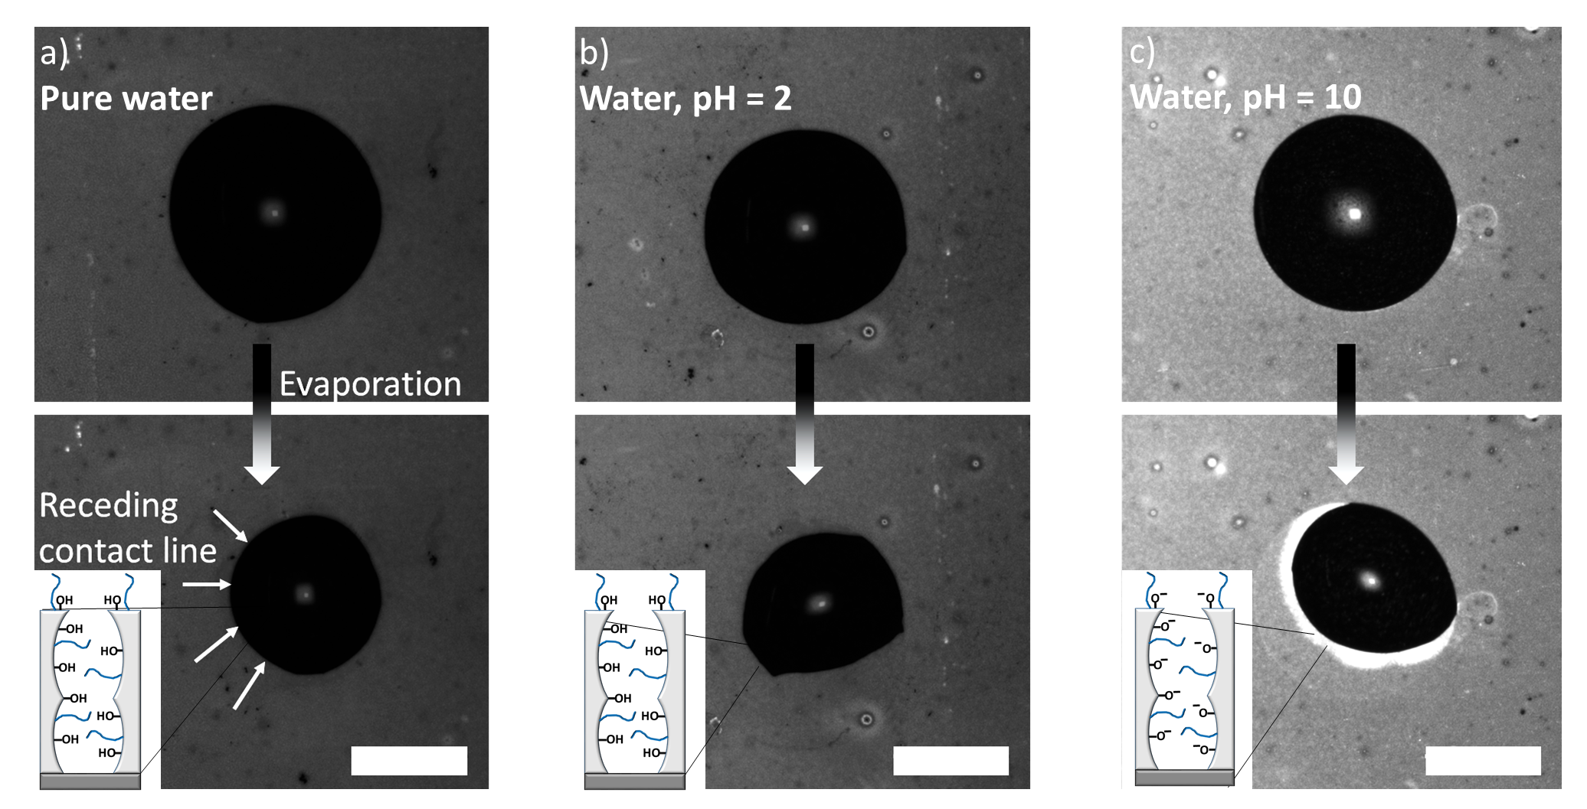
Figure 5

