Slide 1
Wetting-Controlled Localized Placement of Surface
Functionalities within Nanopores
Maria Ochs, Reza Mohammadi, Nicolas Vogel, and Annette Andrieu-Brunsen
https://doi.org/10.1002/smll.201906463
Public Data

Slide 2
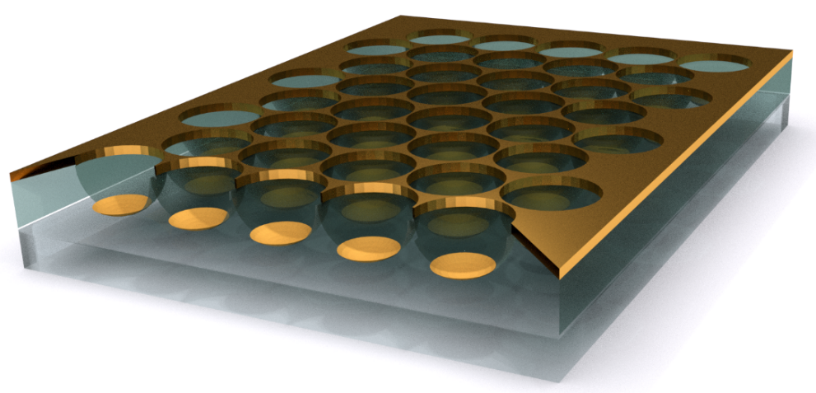
Figure 1
SI-ROMP
thiol self-assembly
initiator
self-assembly
and SI-ATRP
200 nm
1 µm

Slide 3
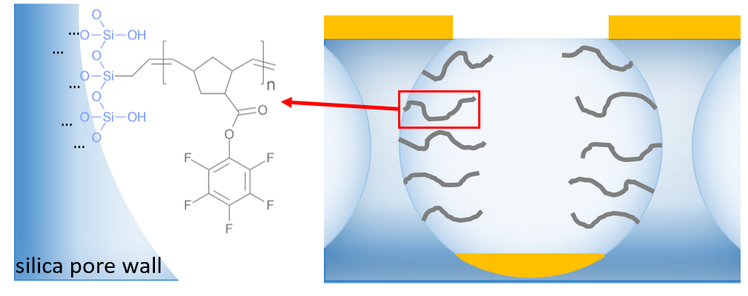
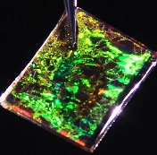
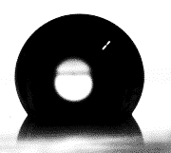
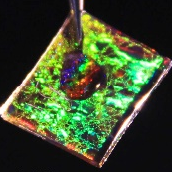
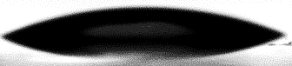
a)
20 nm
Figure 2
Scroll down for the full picture
b)
560 nm
(I)
(II)
C=C
C=C
C=O
C=O
c)
I
II
III
2 µm
2 µm
2 µm
d)
ROMP
20°-30°
110°-130°
e)
catalyst / mg | 5 | 15 | 30 | 15 | 15
time / h | 24 | 24 | 24 | 2 | 6
F:Si | 1.5 | 3.6 | 3.9 | 0.8 | 1.3

Slide 4
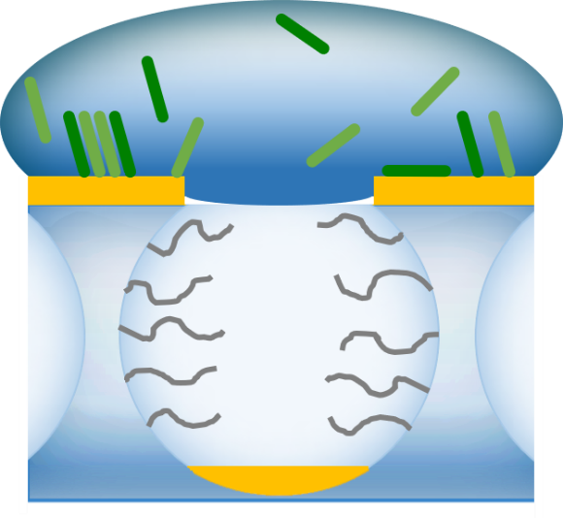
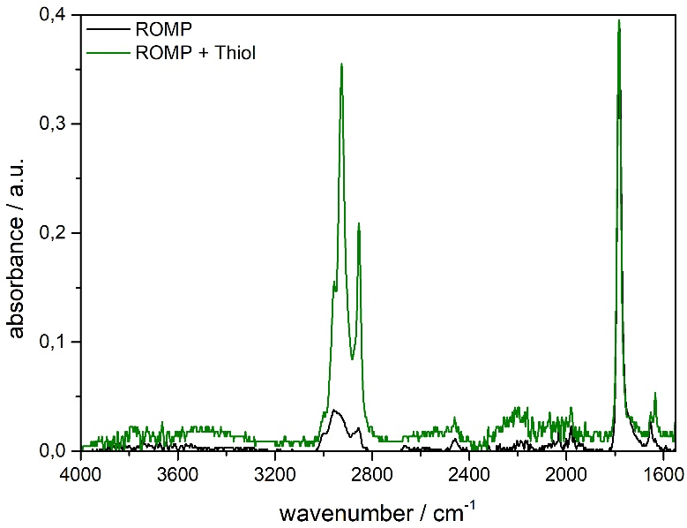
Figure 3
a)
b)
=
=
c)
Au 4f
S 2p
N 1s
Au 4d
Au 4p
C 1s

Slide 5
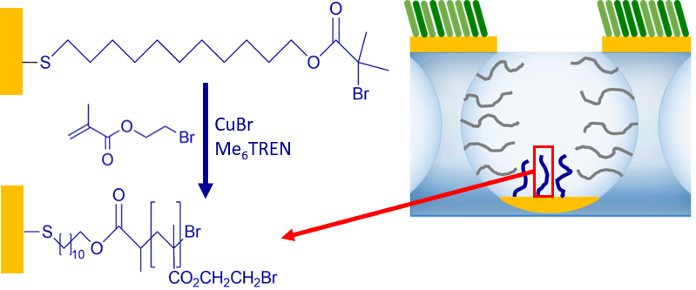
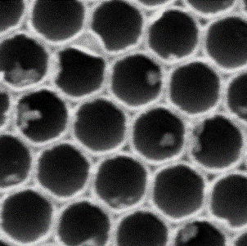
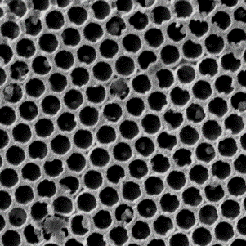
Figure 4
a)
d)
b)
c)
C=O
methacrylate
1 µm
2 µm

Slide 6
Figure 5
a)
b)
F 1s
C 1s
F 1s
F KLL
C 1s
O 1s
Au 4d
Br 3d
Si 2p
Au 4f
Si 2s

