Slide 1
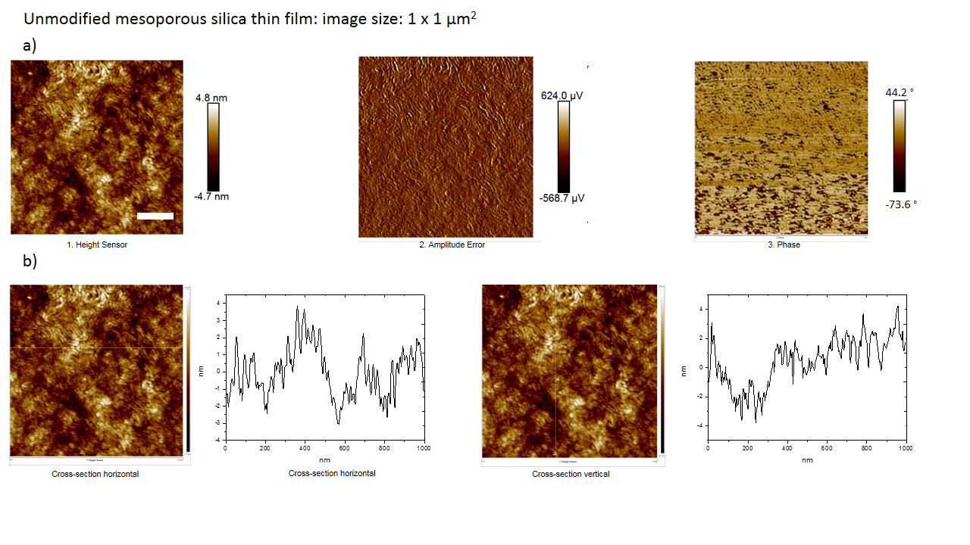
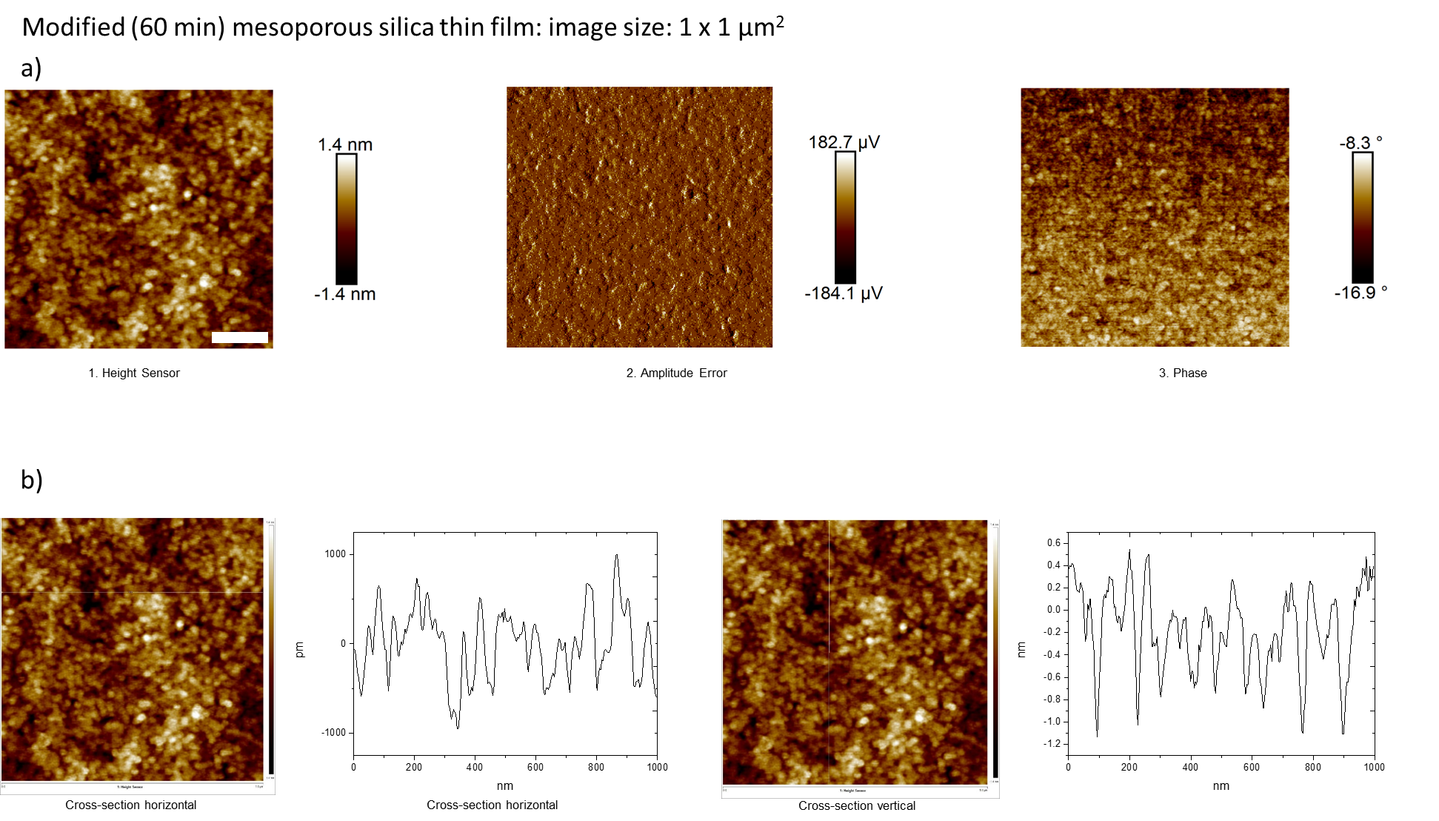
Data from Figure 1:
a)
b)
Scale bar = 200 nm
c)
d)

Slide 2
Data from Figure 2:
a)
b)

Slide 3
Data from Figure 4:

Slide 4
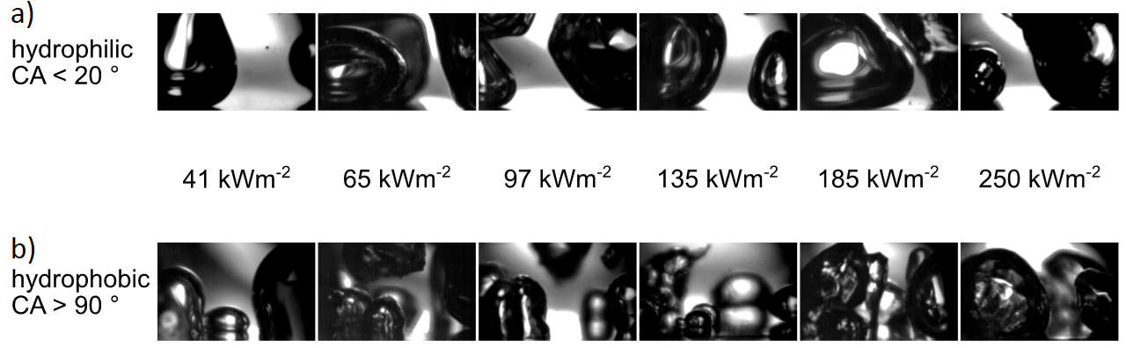
Pictures from Figure 5:

Slide 5
Pictures from Figure S1:

Slide 6
Pictures from Figure S2:

Slide 7
Data from Figure S3:

Slide 8
Data from Figure S4:

Slide 9
Data from Figure S5:

Slide 10
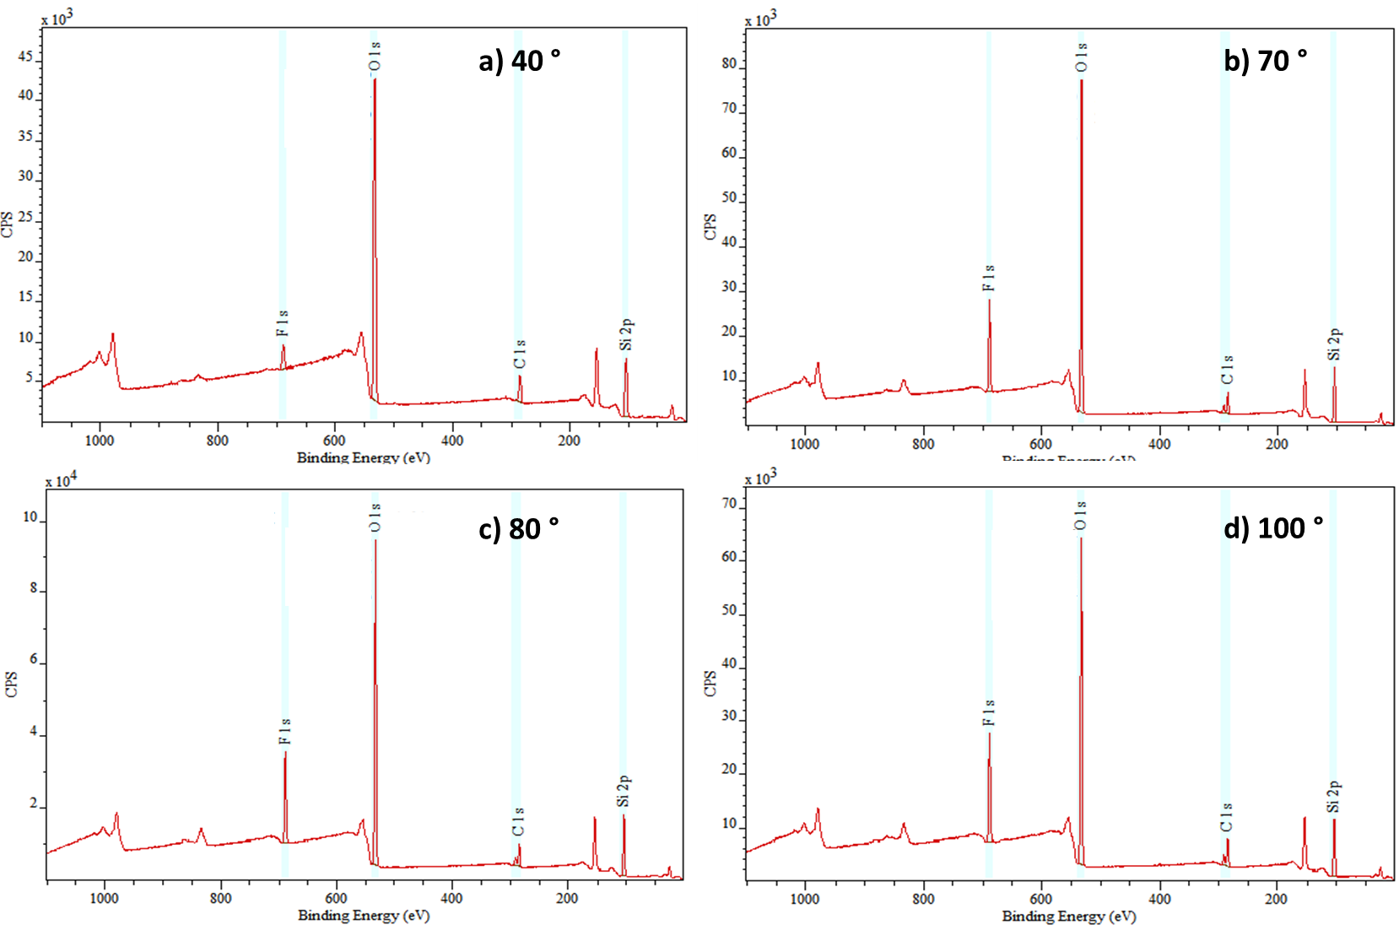
Pictures from Figure S6:

Slide 11
Pictures from Figure S7 & S8:

