Slide 1
Effects of the polymer amount and pH on proton transport in mesopores
Laura Despot, Annette Andrieu-Brunsen
https://doi.org/10.1002/admi.202202456
Public Data

Slide 2
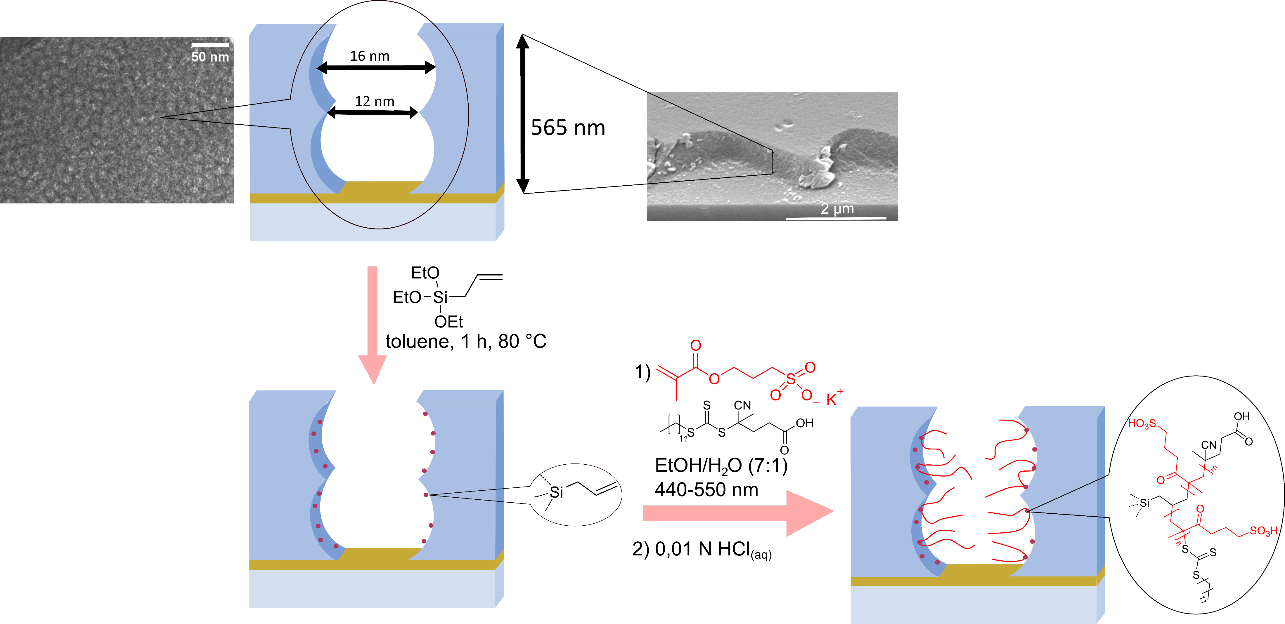
Figure 1

Slide 3
Figure 1 Data

Slide 4
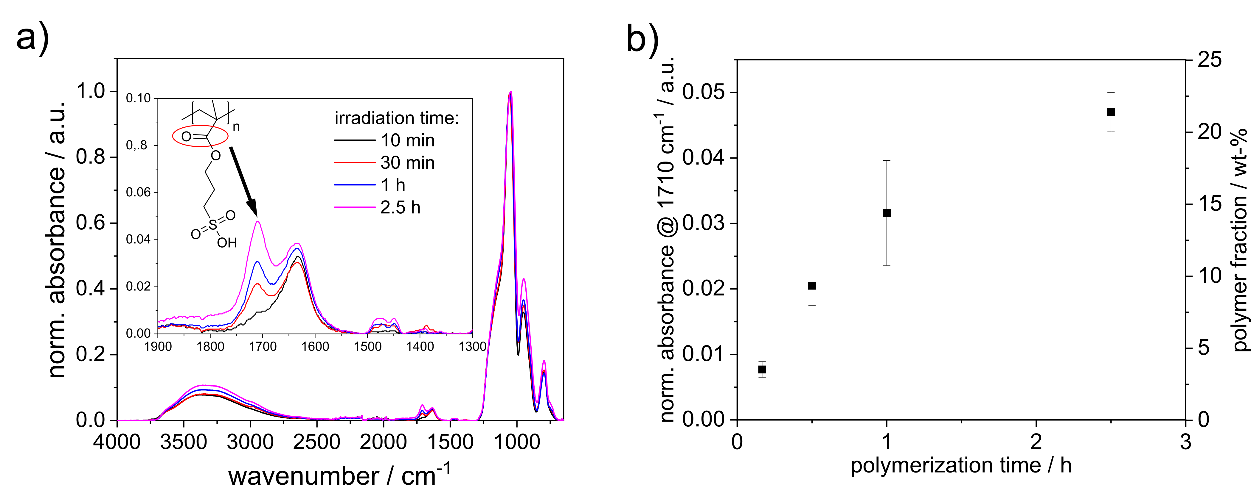
Figure 2

Slide 5
Figure 2 Data

Slide 6
Figure 3

Slide 7
Figure 3 Data

Slide 8
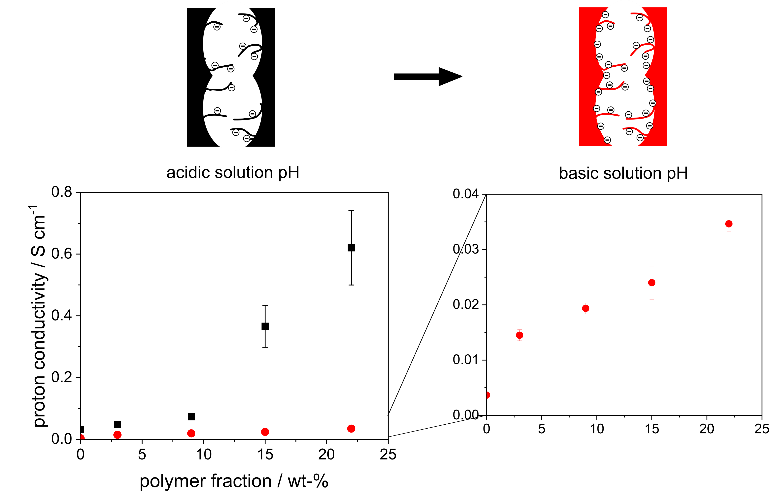
Figure 4

Slide 9
Figure 4 Data

Slide 10
Supporting Information

Slide 11
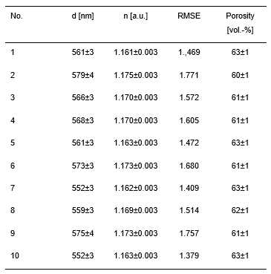
Table S1

Slide 12
Figure S1

Slide 13
Figure S2

Slide 14
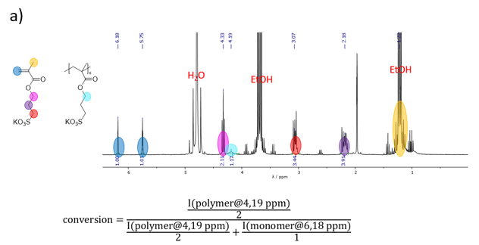
Figure S3
b)

Slide 15
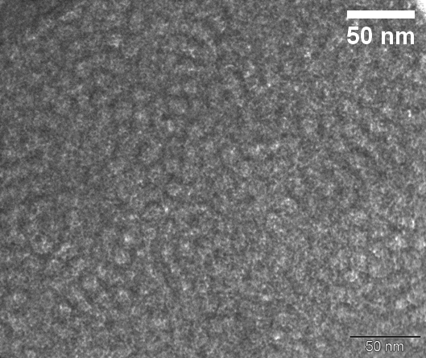
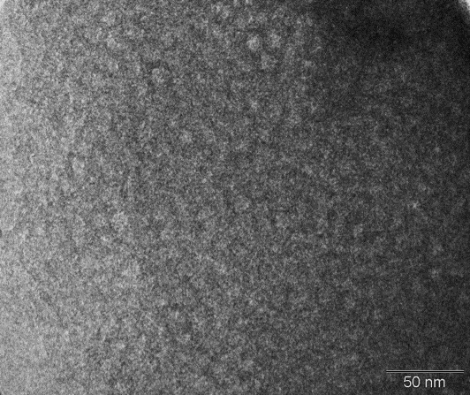
Figure S4
a)
b)
c)
d)

Slide 16
Figure S5

Slide 17
Figure S6

Slide 18
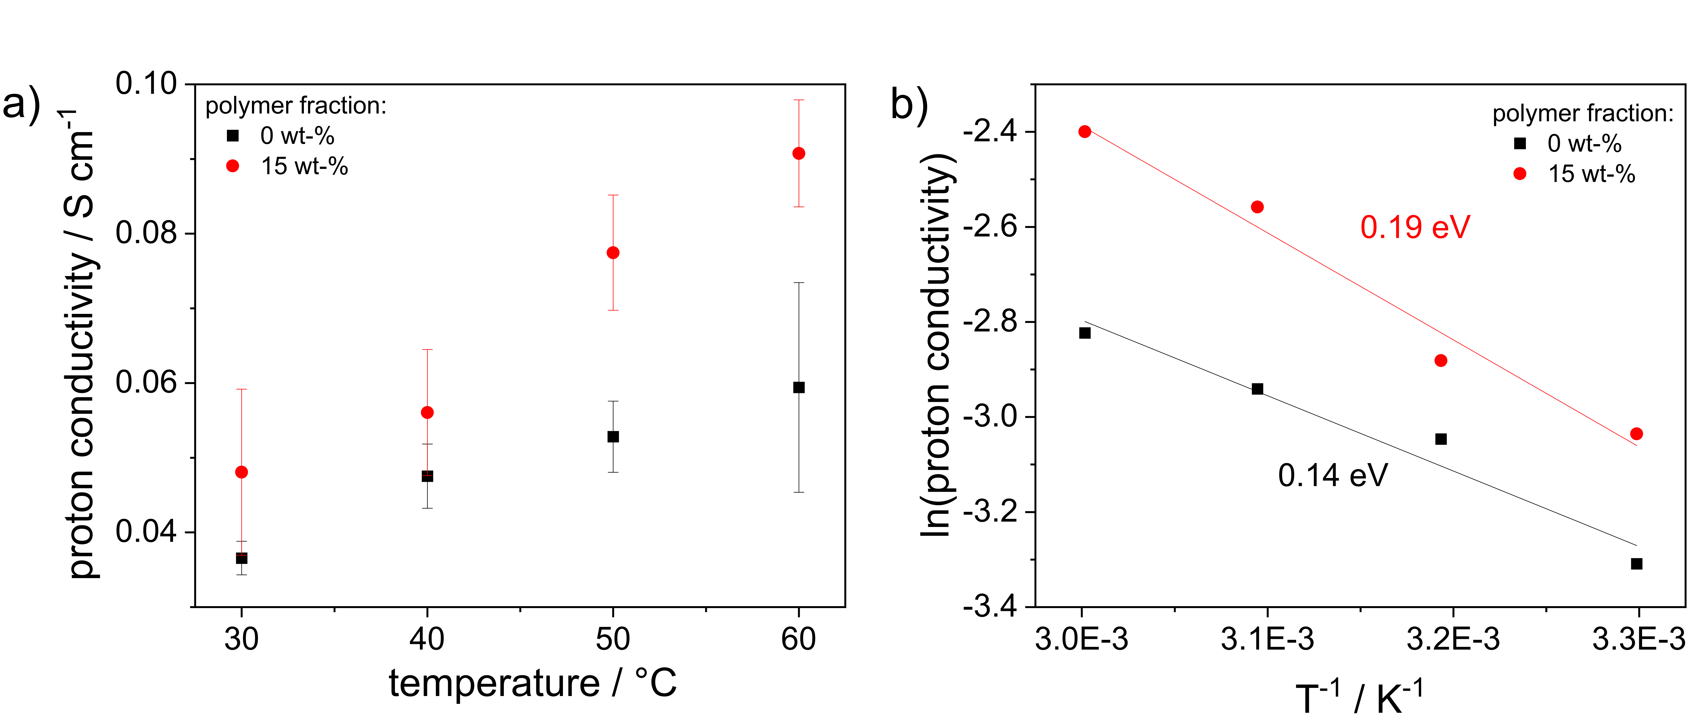
Figure S7

Slide 19
Figure S7 Data

Slide 20
Figure S8

Slide 21
Figure S9
CV:
2021-03-23-LD-433
2021-05-05-LD-459
2021-07-29-LD-558-01+02
2021-08-11-LD-568-LD-568-3+2
Measurements of samples:
2021-03-22-LD-431
2021-05-05-LD-459
2021-07-29-LD-558-3+4
2021-08-09-LD-565-3+2
CV:
2021-02-28-LD-414
Measurements of samples: 2021-02-01-LD-381

Slide 22
Figure S10

Slide 23
Figure S11

Slide 24
Figure S12

