Slide 1
Functional Metalloblock Copolymers for the Preparation and In Situ Functionalization of Porous Silica Films
Nicole Herzog, Hanna Hübner, Christian Rüttiger, Markus Gallei,* and Annette Andrieu-Brunsen
https://dx.doi.org/10.1021/acs.langmuir.0c00245
Public Data

Slide 2
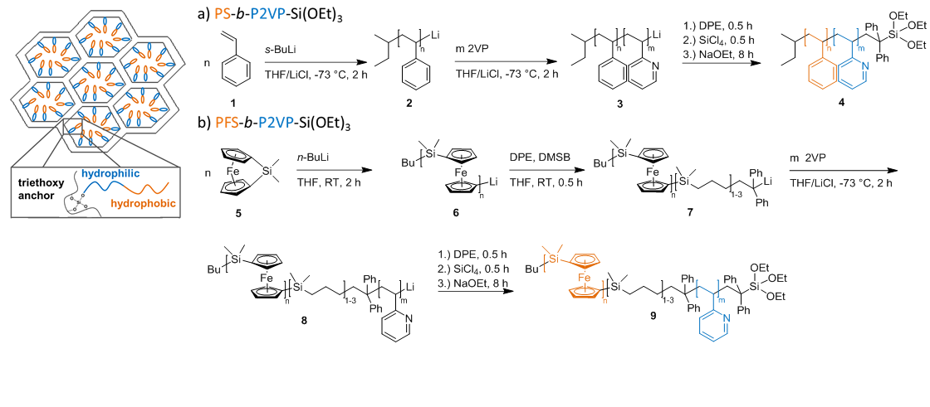
Scheme 1

Slide 3
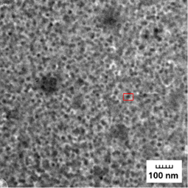
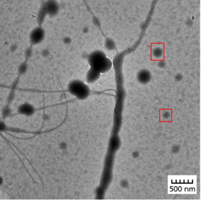
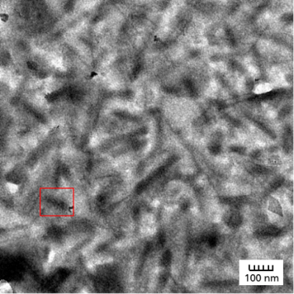
Figure 1
c)
d)
e)

Slide 4
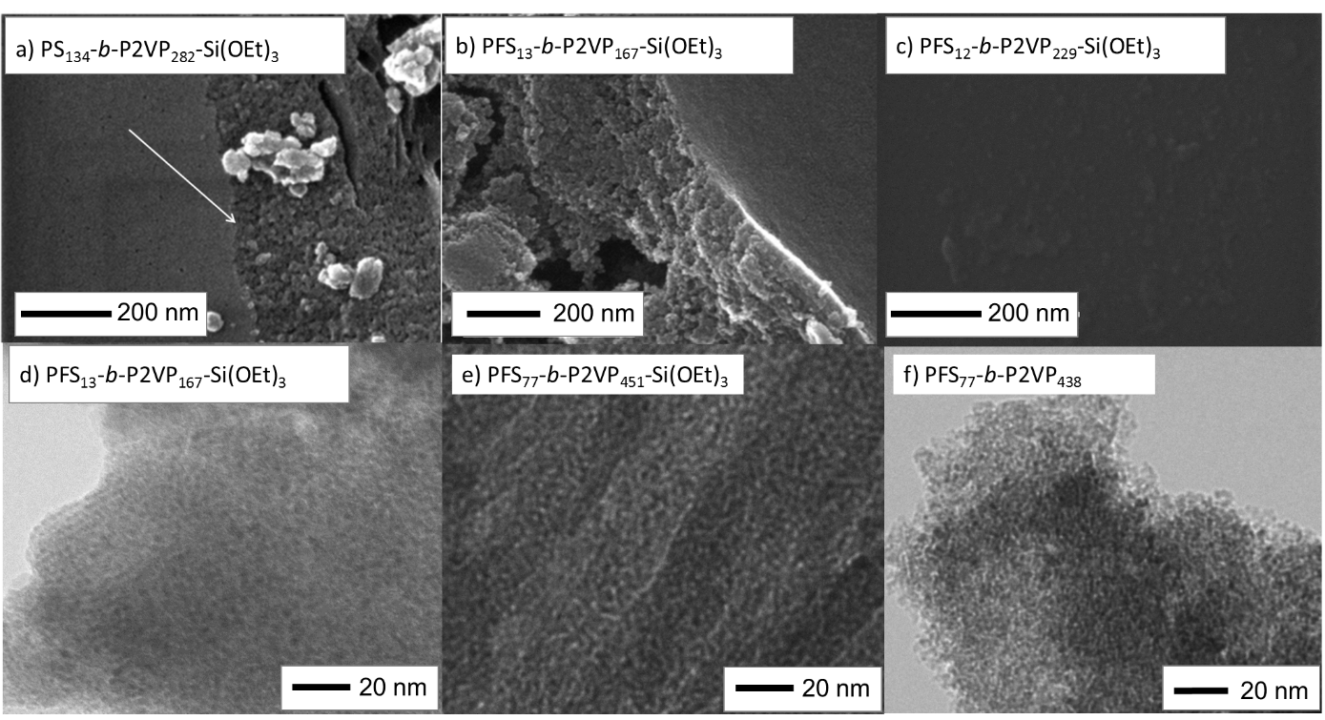
Figure 2

Slide 5
Figure 3

Slide 6
Figure 4

Slide 7
Figure 5

