Slide 1
Insights into the interplay of wetting and transport in mesoporous silica films
Adnan Khalil, Matthias Zimmermann, Alena K. Bell, Ulrike Kunz, Steffen Hardt, Hans-Joachim Kleebe, Robert W. Stark, Peter Stephan, Annette Andrieu-Brunsen
https://doi.org/10.1016/j.jcis.2019.09.093
Public Data

Slide 2
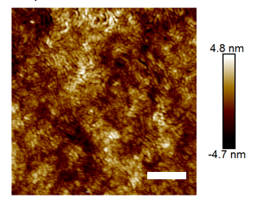
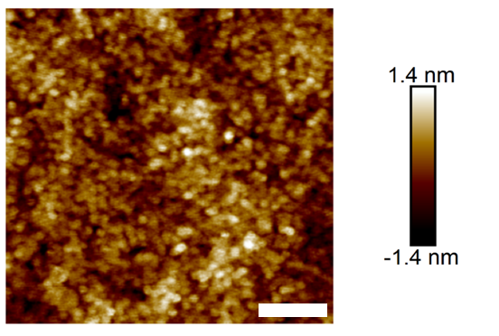
Figure 1

Slide 3
Figure 2

Slide 4
Figure 4

Slide 5
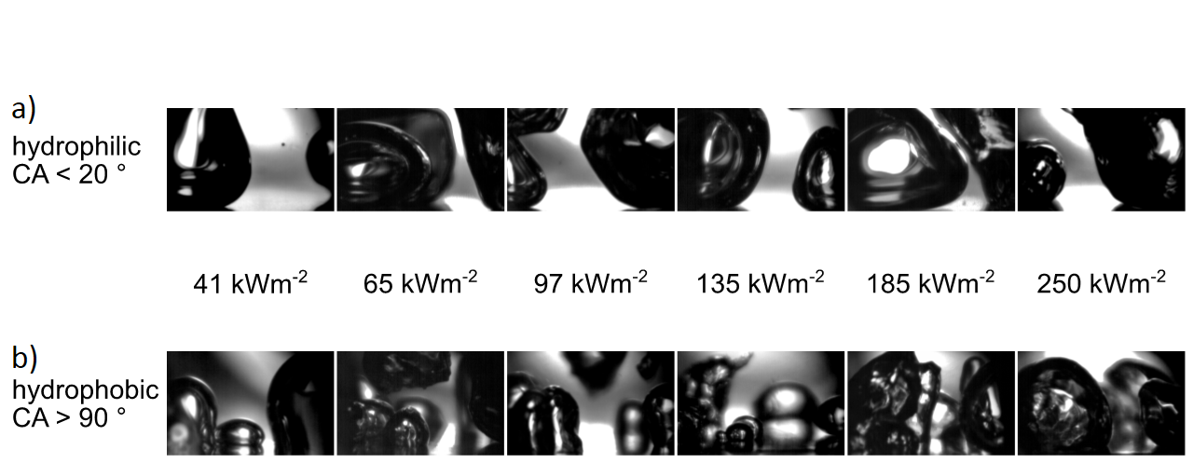
Figure 5

