Slide 1

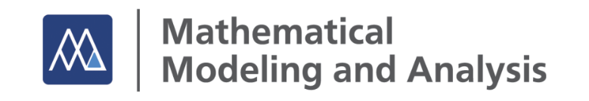
Modelling of Transport Processes in Multicomponent Two-Phase Fluid Systems
Dieter Bothe
Technische Universität Darmstadt
Jahrestreffen der DECHEMA / VDI-Fachgruppen
Mischvorgänge, Hochdruckverfahrenstechnik
und Mehrphasenströmungen
TU Hamburg, Germany
March 19 - 21, 2025

Slide 2
Contents
I – Introduction
Continuum thermodynamical description of
II – Fluid Systems
III – Clean Fluid Interfaces
IV – Actual Fluid Interfaces

Slide 3
Motivation: Mass Transfer at Fluid Interfaces
Process Intensification ► high concentrations, high p,T, transient non-linear processes
Process Optimization & Uncertainty Quantification ► high fidelity, quantitatively accurate & efficient CFD required
Mathematical Models ► validated, thermodynamically consistent models required that capture all relevant scales, mechanisms & phenomena
Fundamental reseach on local phenomena ► prototypical setups with single (or few) fluid particles need to be investigated via experimental, theoretical and numerical methods

Slide 4
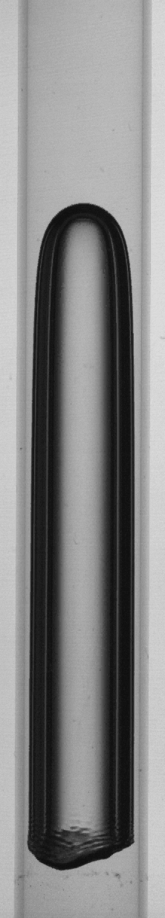
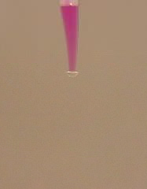
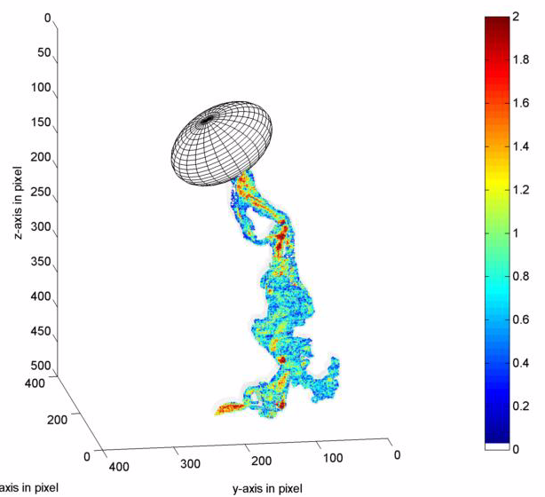
Motivation: Mass Transfer at Fluid Interfaces
initial droplet: NaOH,
water, phenolphtalein
ambient liquid:
toluol, acetic acid
N₂-sat. dye solution/O₂
T = 20.2 °C
p = 1017.4 mbar
d_{eq,V,ris} = 4.3 mm
w_{b}= 26 cm∙s⁻¹
CO₂ bubble
rising and dissolving
in water
oxygen concentration in mg L⁻¹
Time Resolved Scanning Laser Induced Fluorescence
Matthias Kraume, TU Berlin
Michael Schlüter, IMS, TU Hamburg
Akio Tomiyama, U Koebe

Slide 5
Aim of this lecture
Fluid Mixtures
Fluid Interfaces
Transport
Transfer
Fluid Systems
Transformation
Chemical Reactions
Overview of continuum thermodynamical modeling of fluid systems
Shortcomings of standard models and how to overcome them
Extensions of the model to capture local mass transfer resistance

Slide 6
Different Levels of Modeling
Molecular Dynamics
=> N-body problem from Newtonian mechanics
Kinetic Theory
=> Boltzmann Equation(s)
Continuum Physics
=> Balance of extensive quantities

Slide 7
Continuum Modeling of Irreversible Processes
There are different brands of continuum thermodynamic models but they all share the following features:
balance equations of relevant extensive quantities such as (molar) mass, momentum, energy
the second law of thermodynamics
incorporation of material properties (in some way)
fullfilment of general physical principles such as material frame indifference (independence from observer)

Slide 8
Continuum Modeling of Irreversible Processes
There are different brands of continuum thermodynamic models but they all share the following features:
balance equations of relevant extensive quantities such as (molar) mass, momentum, energy
the second law of thermodynamics
Theory of Irreversible Processes
Rational Thermodynamics
Continuum Thermodynamics
GENERIC
Meixner, De Groot, Mazur, …
Truesdell, Noll, Gurtin, Müller, Ishi Liu, …
Bothe, Dreyer, Druet, …
Grmela, Öttinger, …

Slide 9
Contents
I – Introduction
Continuum thermodynamical description of
II – Fluid Systems
III – Fluid Interfaces
IV – Transfer Processes

Slide 10
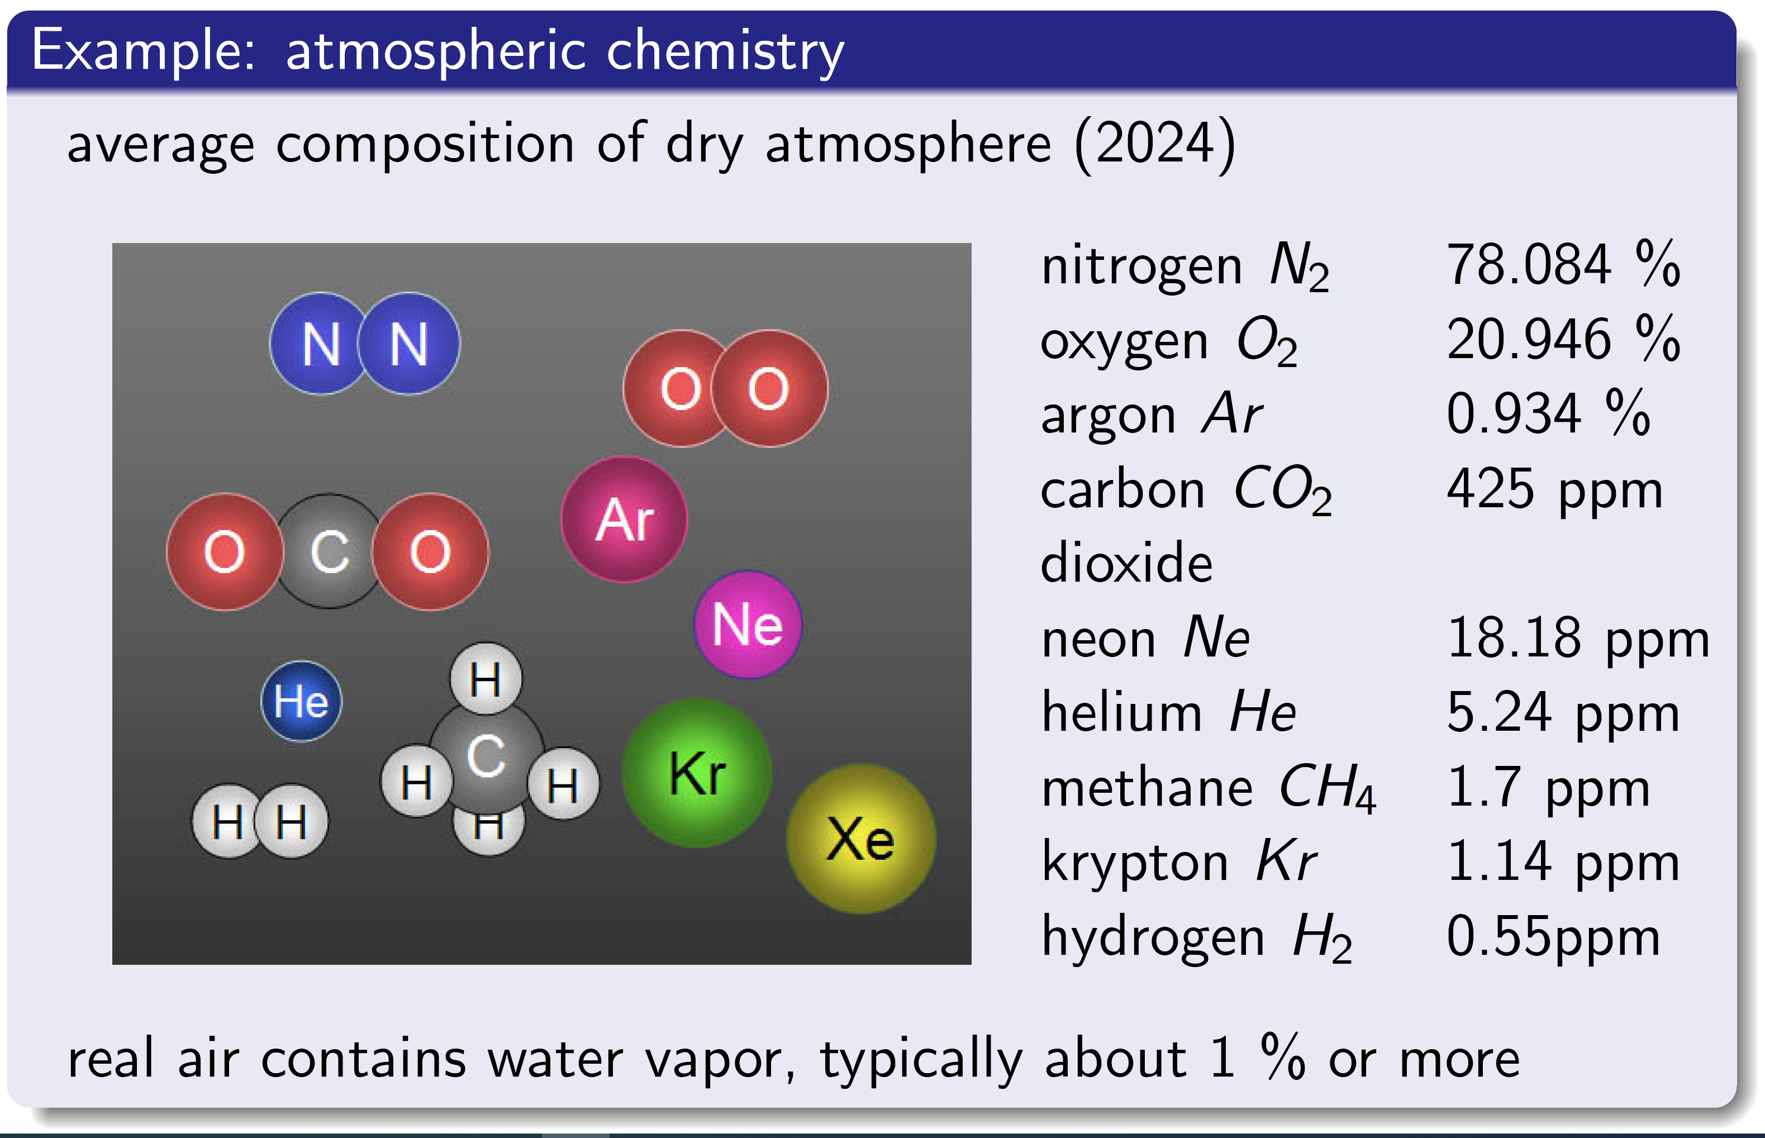
Multicomponent Fluid Systems
CLAIM: Every real-world fluid is a multicomponent mixture !
http://www.chemistryland.com

Slide 11
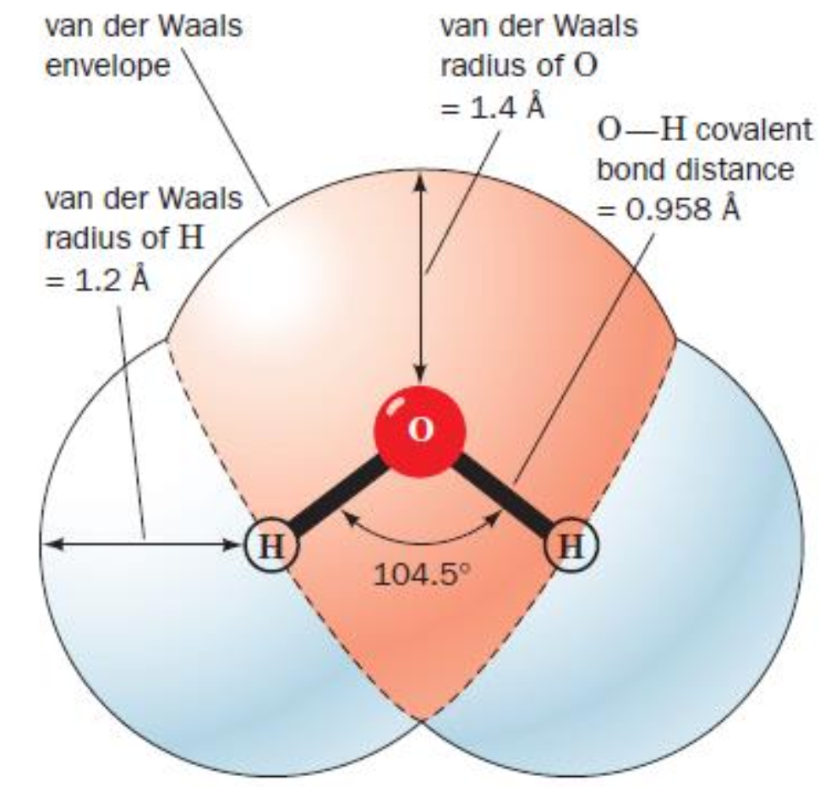
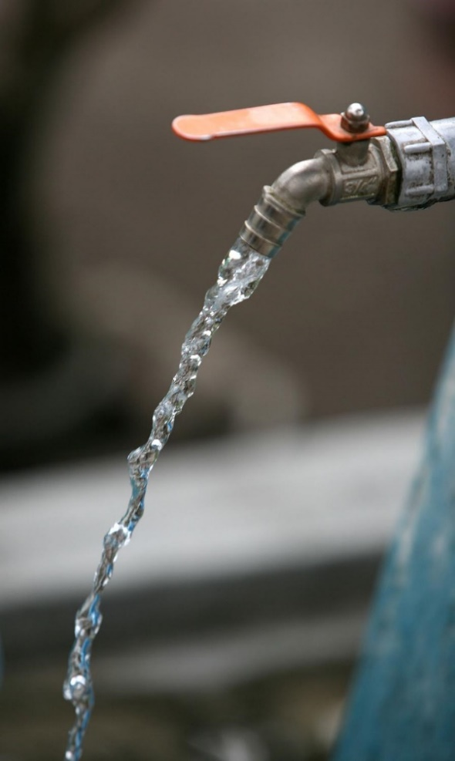
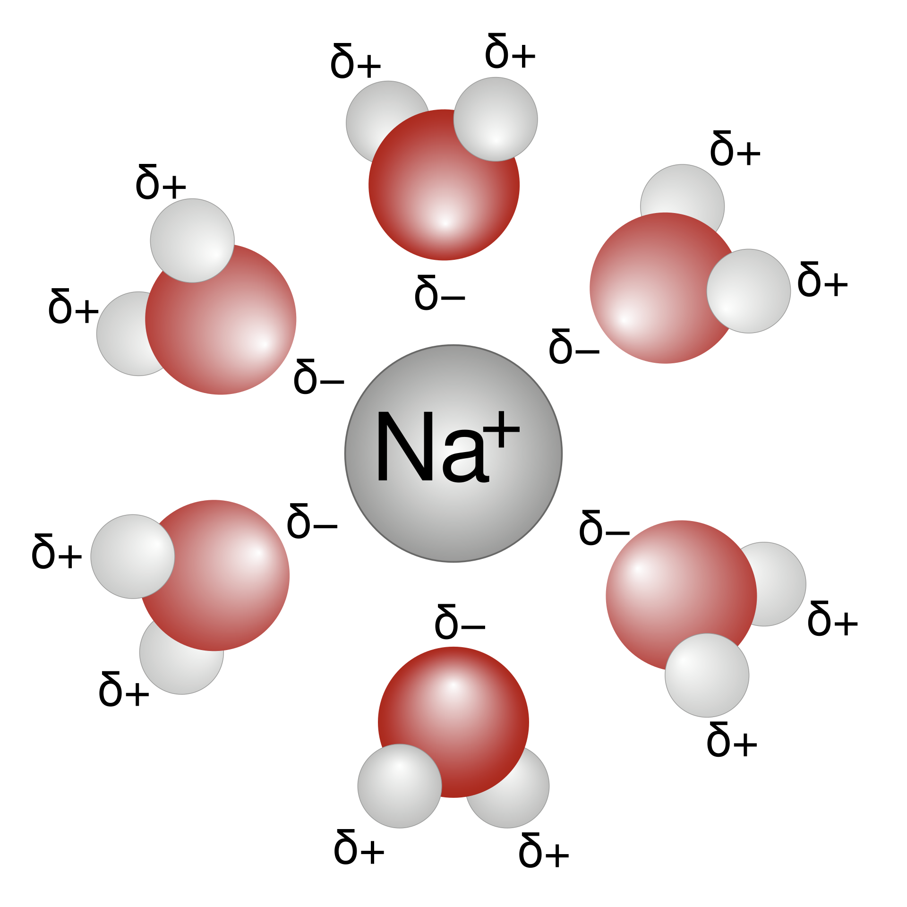
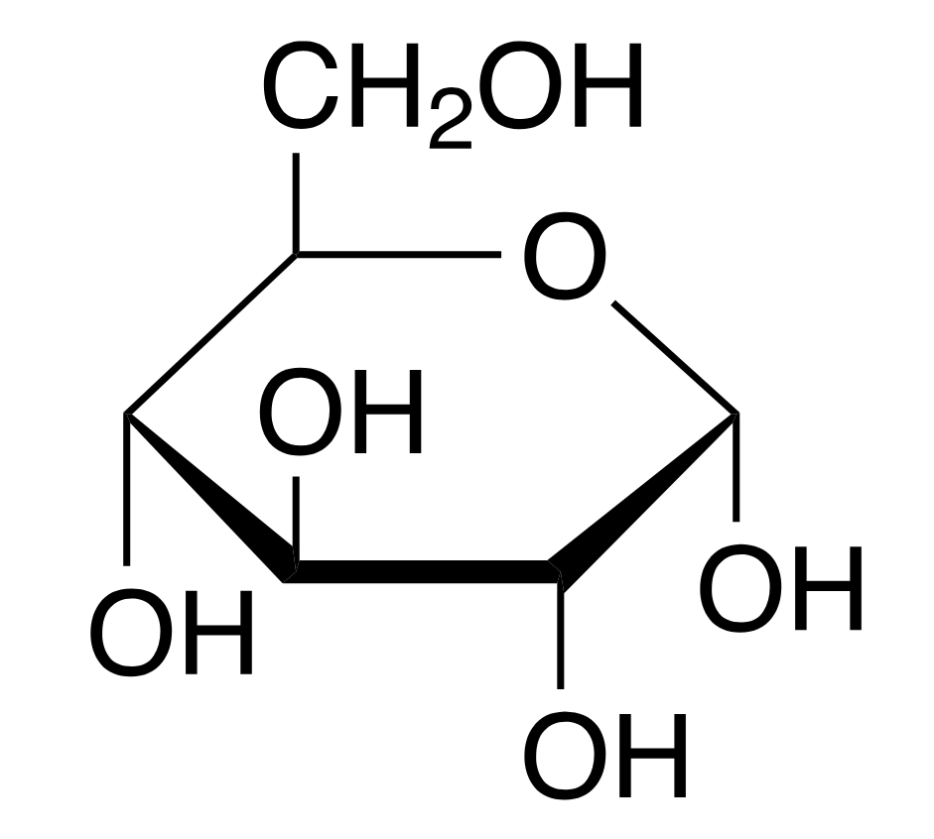
Multicomponent Fluid Systems
CLAIM: Every real-world fluid is a multicomponent mixture !
Typical contents of tap water: H₂O and
N₂, O₂, Ar, CO₂, … (see slide above)
ions: H₃O⁺, Na⁺, K⁺, Mg²⁺, Ca²⁺, OH⁻, Cl⁻, NO₃⁻, SO₃²⁻, …
contaminants such as pesticides, arenes, …
glucose, in your coffee or tea
some of these are
surface active agents
= surfactants
A sodium ion solvated
by water molecules; from Wikipedia
An outdoor drinking water tap at Desa Dasan Geria Village, West Lombok; from Wikipedia
glucose molecule; from Wikipedia
Source for water molecule structure: https://kmy-fef.marmara.edu.tr/dosya/fef/kmy/Anabilim%20Dallar%C4%B1/Biyokimya/YeniKlasor/02%20Water%20v2.pdf

Slide 12

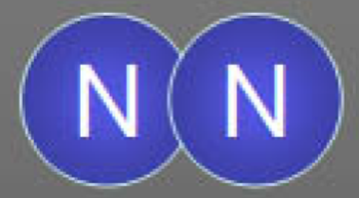
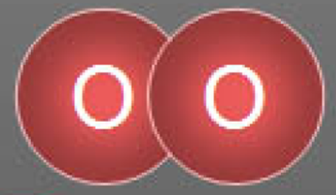
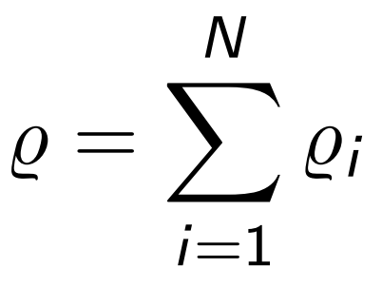
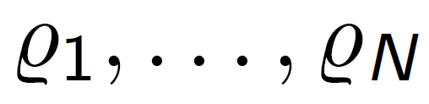
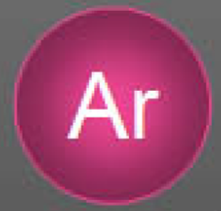

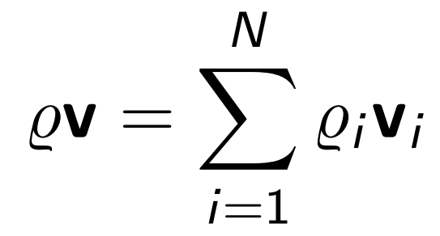
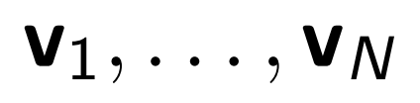
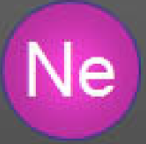
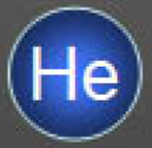
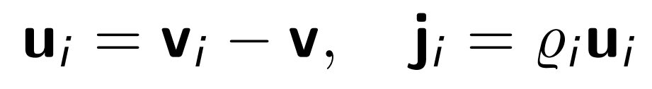
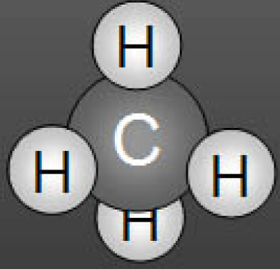
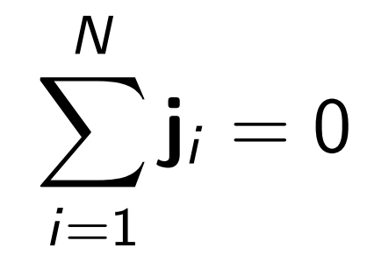
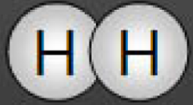
Chemically Reacting Fluid Mixtures
Notation.
Fluid composed of N chemical components ( = constituents or species):
constituents
A₁
A₂
mass densities
A₃
A₄
velocities
A₅
A₆
diffusion
velocities
A₇
diffusion
fluxes
A₈

Slide 13

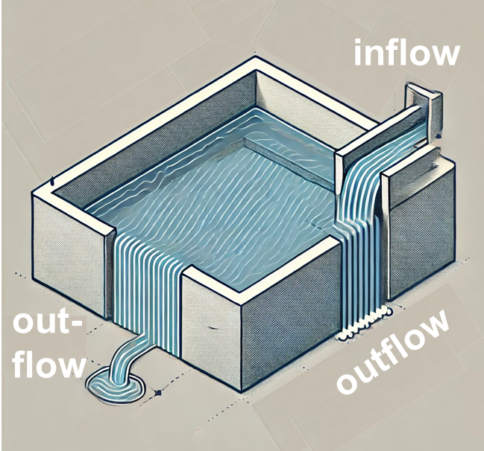
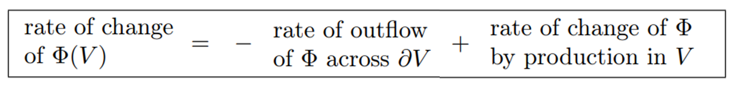
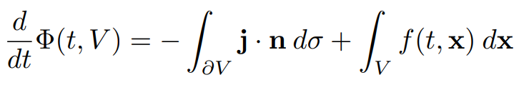
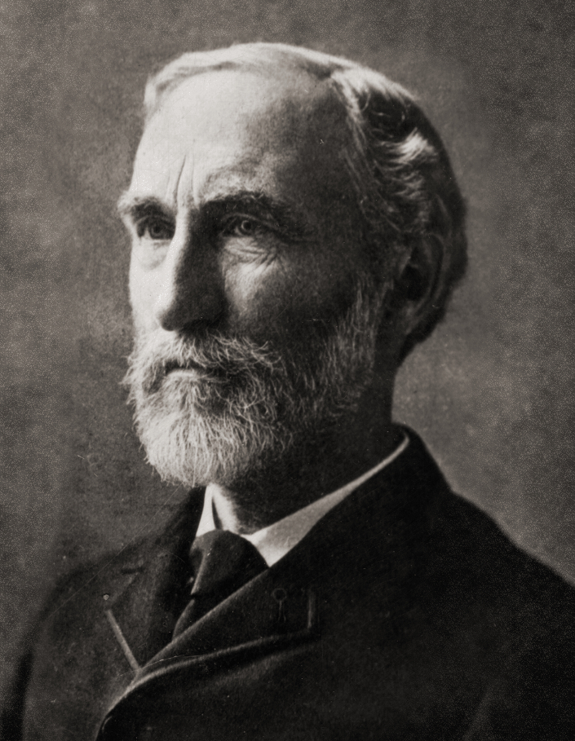

Balance Equations
chatGPT
integral master balance
“Mathematics is also a language”
JOSIAH WILLARD GIBBS
1839-1903
differential (local) form
Wikipedia

Slide 14
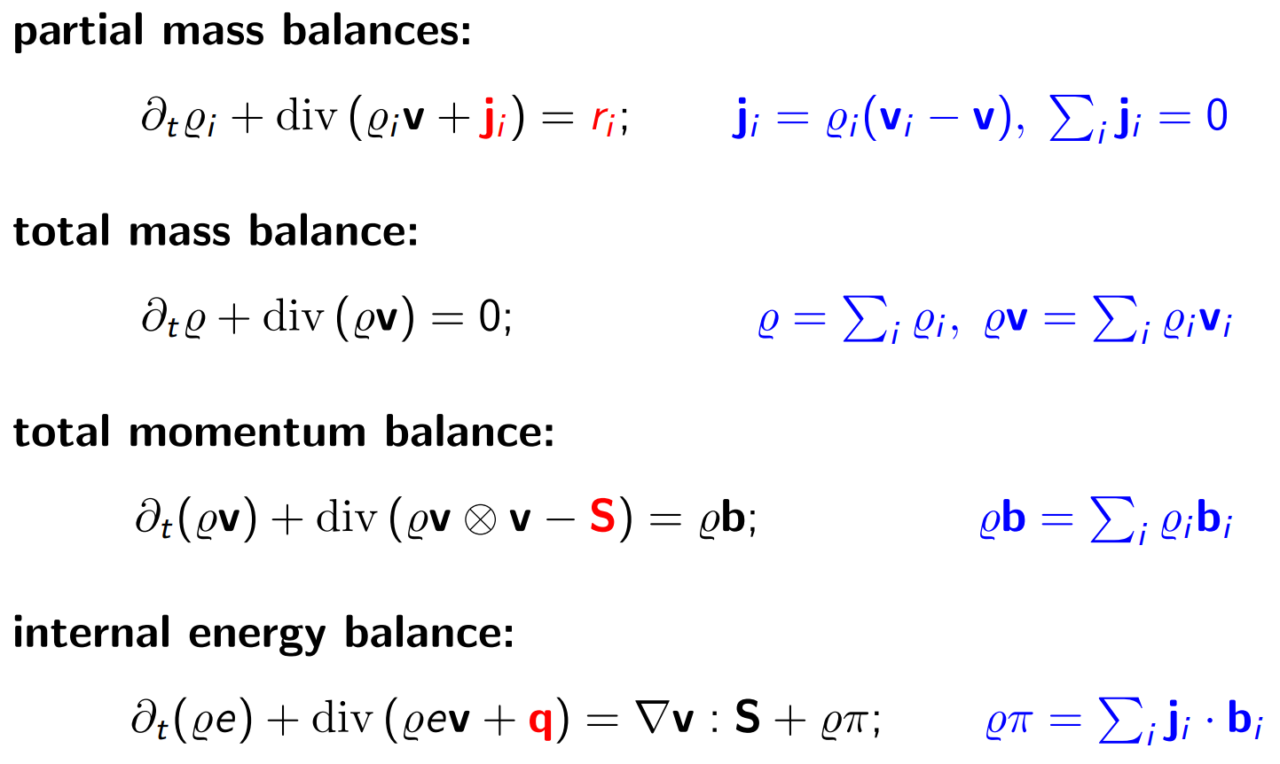
Balance Equations
marked in red: constitutive quantities
example: mass (species) diffusion

Slide 15
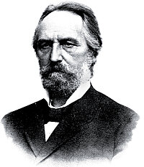
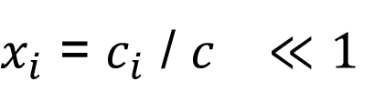
Fickean Diffusion
Classical diffusion flux model:
Fick‘s „law“:
applicable only for a dilute mixture, i.e.
Wikipedia
for multicomponent diffusion:
Adolf E. Fick
1829-1901
► inconsistent with the conservation of mass
► unclear how to appropriately include cross-effects:
‚naive‘ generalization cannot describe experiments

Slide 16
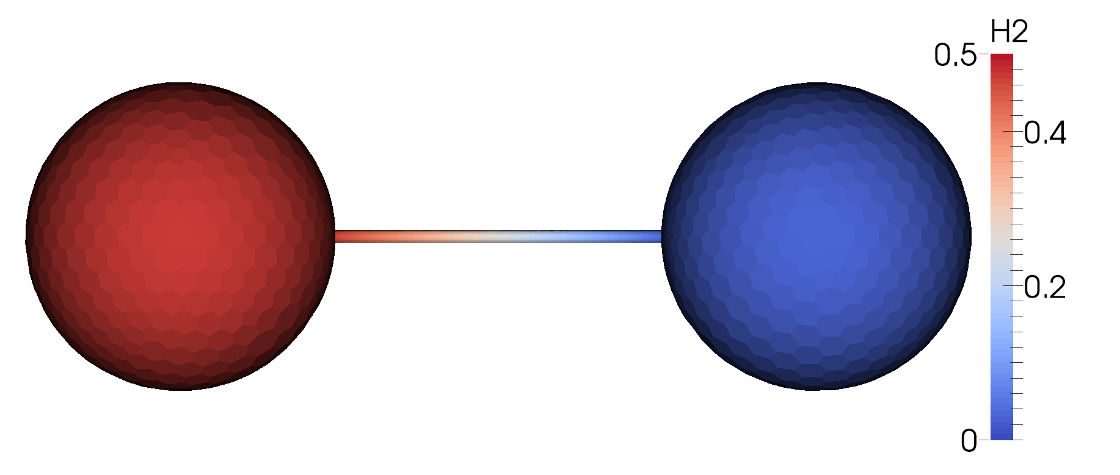
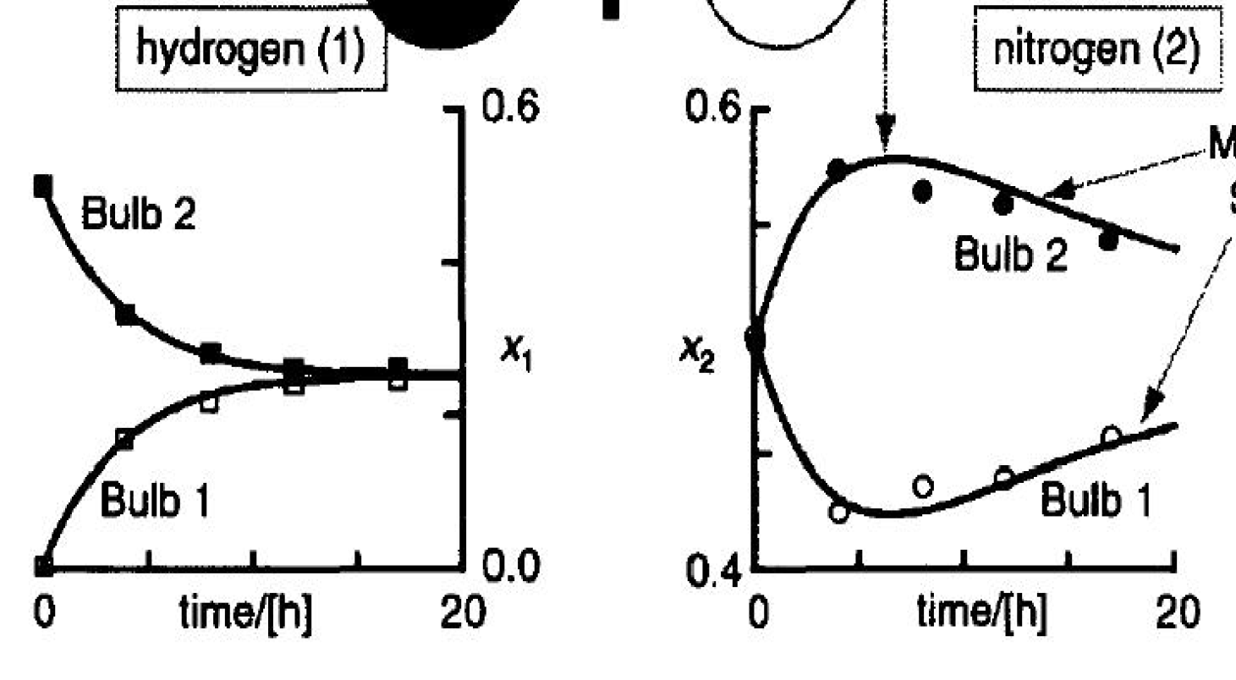

Duncan-Toor Experiment*
Classical experiment on cross-diffusion:
hydrogen
nitrogen
initial
composition:
H₂ = 0.5
N₂ = 0.5
CO₂ = 0.0
initial
composition:
H₂ = 0.0
N₂ = 0.5
CO₂ = 0.5
Thermodynamic framework for multicomponent diffusion ?
*) J.B. Duncan, H.L. Toor: An experimental study of three component gas diffusion, AIChE Journal 8, 38-41 (1962).

Slide 17
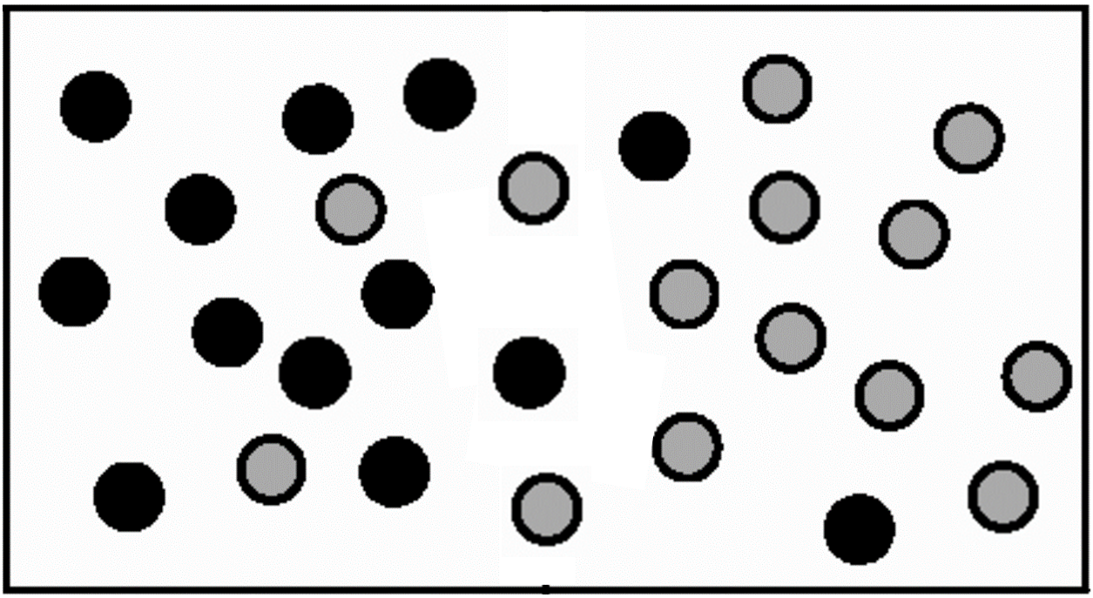
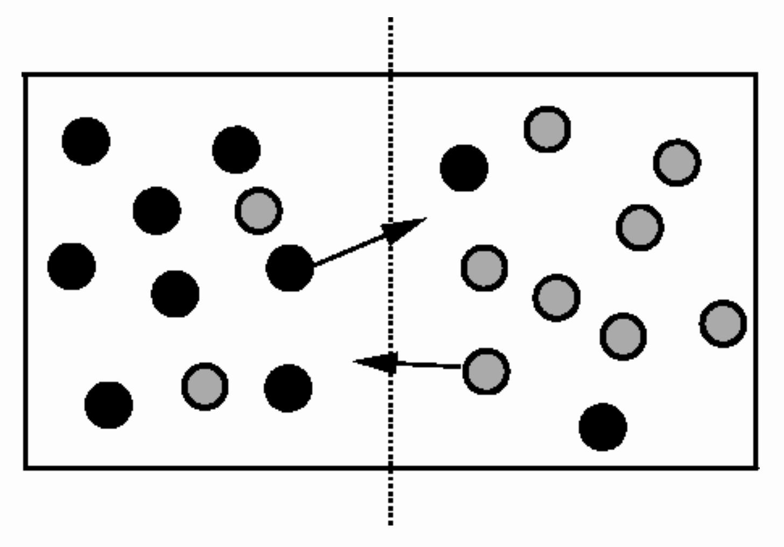
Driving Force of Diffusion
What drives mass diffusion?
location 1
location 2
molecular viewpoint
forces between different types of molecules
continuum viewpoint
chemical potentials: _{i}
A rich
B rich
at given p, T and composition (x₁, …, x_{N}), how much work is required to add one molecule of species i to the fluid system?
$$μ_{i}^{1}\left(p,T,x_{1}, …,x_{N}\right)>μ_{i}^{2}\left(p,T,x_{1}, …,x_{N}\right)$$
⇒ the total energy of the system can be lowered by transport of species i from location 1 to location 2
Differences in chemical potentials drive mass diffusion !

Slide 18
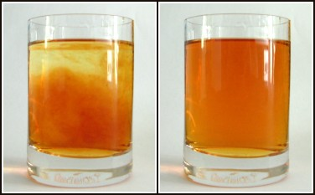
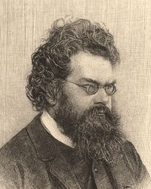
Diffusion as an Irreversible Process
How to derive a continuum thermodynamic diffusion model?
add the second law of thermodynamics to the picture !
► The Entropy Principle
S = k_{B} log W
S = numerical value of entropy,
k_{B} = (universal) Boltzmann constant,
W = number of micro-states that are possible in the given macro-state
source: Wikipedia
Wikipedia
Diffusion: an irreversible process
Ludwig Boltzmann
1844 – 1906
► The entropy of an isolated system cannot decrease
Note that W is often erroneously called ‘probability’, which would render S a negative quantity.

Slide 19
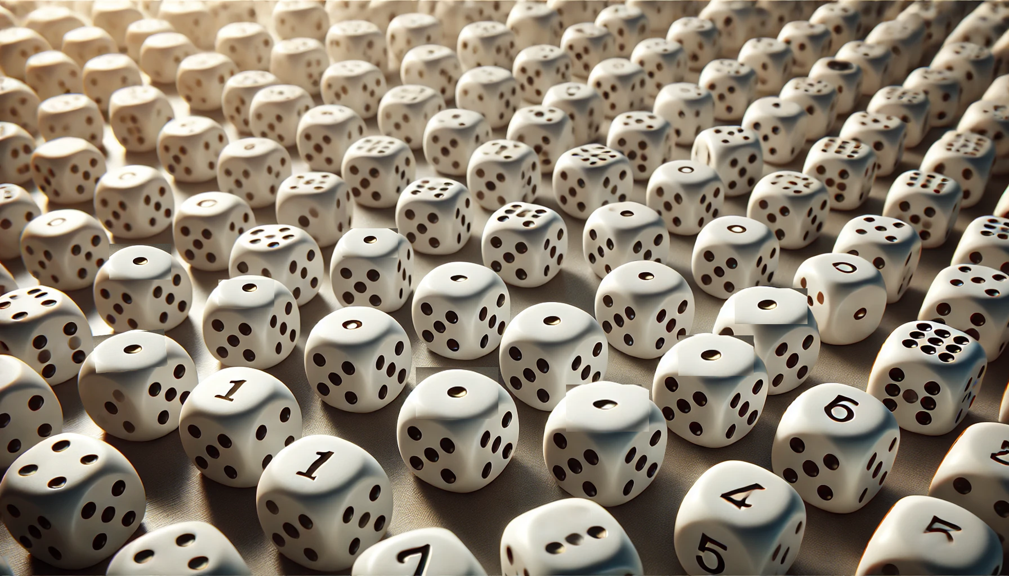

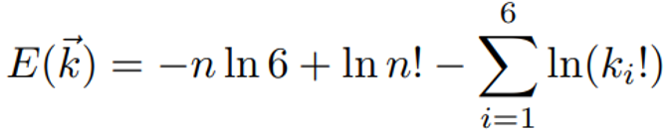
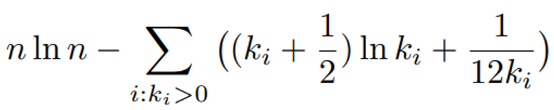

The Second Law of Thermodynamics
Imagine n dices sitting on a table (showing 1 pip)
n dices with 1 … 6 pips
macro state = number of dices
showing 1, 2, …, 6 pips, i.e.
chatGPT
Stirling‘s formula yields
give a push to the table such that each dice will - stay as it is with probability 0.5 - tilt over to rest on a neighboring face, with equal probability 0.125 for each face
after one unit of time continue at step 1
Boltzmann entropy for macro state
D. Bothe, T. Maric, TU Darmstadt 2025

Slide 20
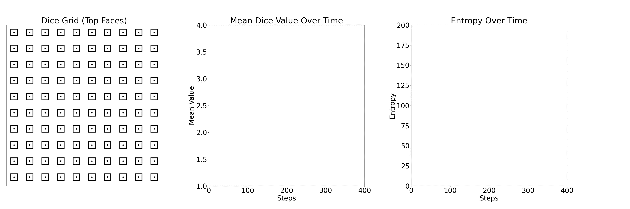
The Entropy in a System of n Dices
n = 10 x 10 dices
micro state of n dices
mean value for micro state
Boltzmann entropy
of macro state
D. Bothe, T. Maric, TU Darmstadt 2025

Slide 21
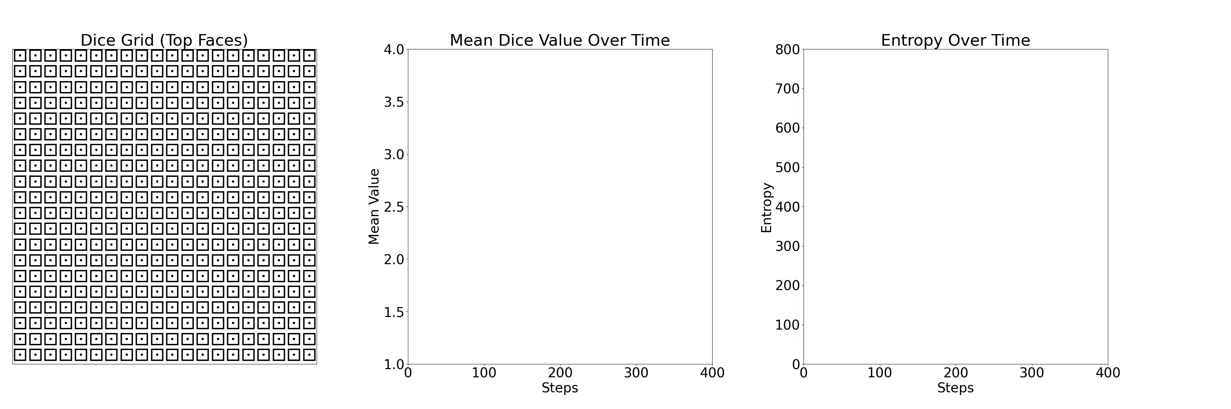
The Entropy in a System of n Dices
n = 20 x 20 dices
micro state of n dices
mean value for micro state
Boltzmann entropy
of macro state
D. Bothe, T. Maric, TU Darmstadt 2025

Slide 22
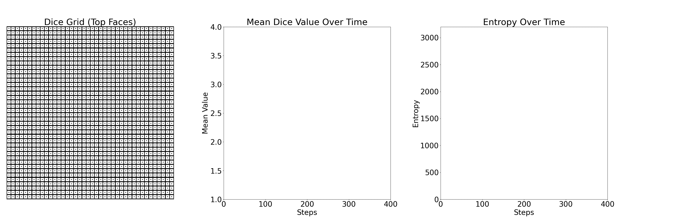
The Entropy in a System of n Dices
n = 40 x 40 dices
micro state of n dices
mean value for micro state
Boltzmann entropy
of macro state
Note: final approach to equilibrium is exponential; before: not!
D. Bothe, T. Maric, TU Darmstadt 2025

Slide 23
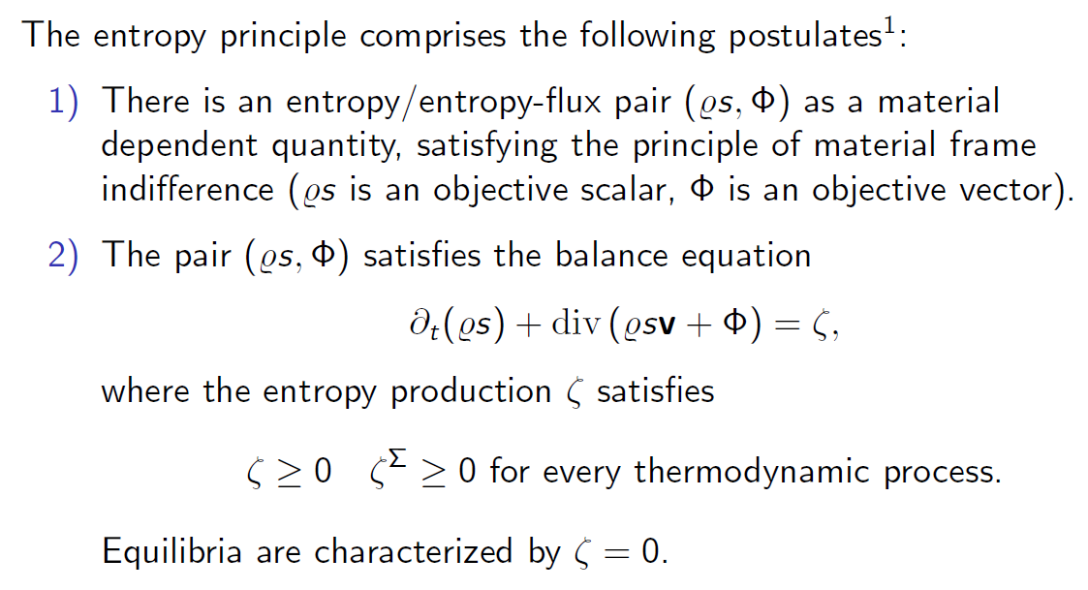
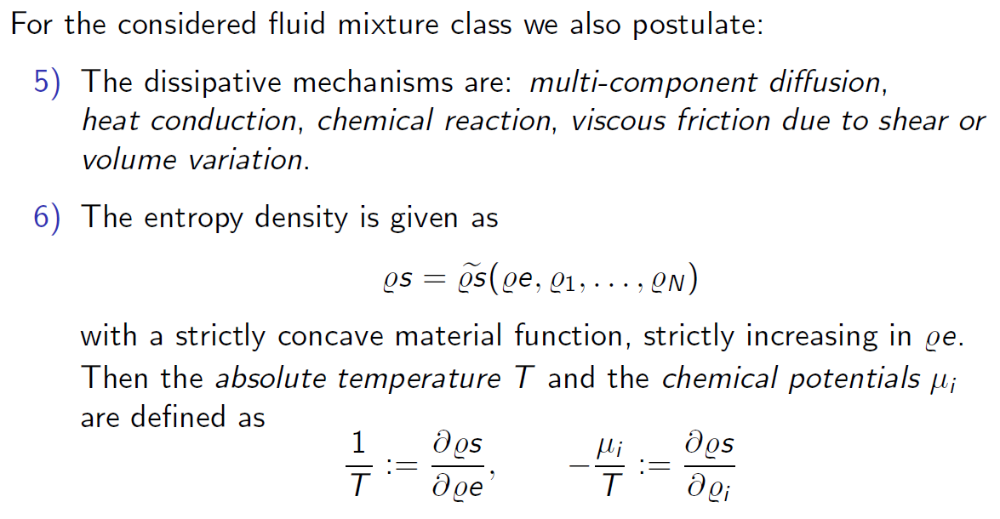
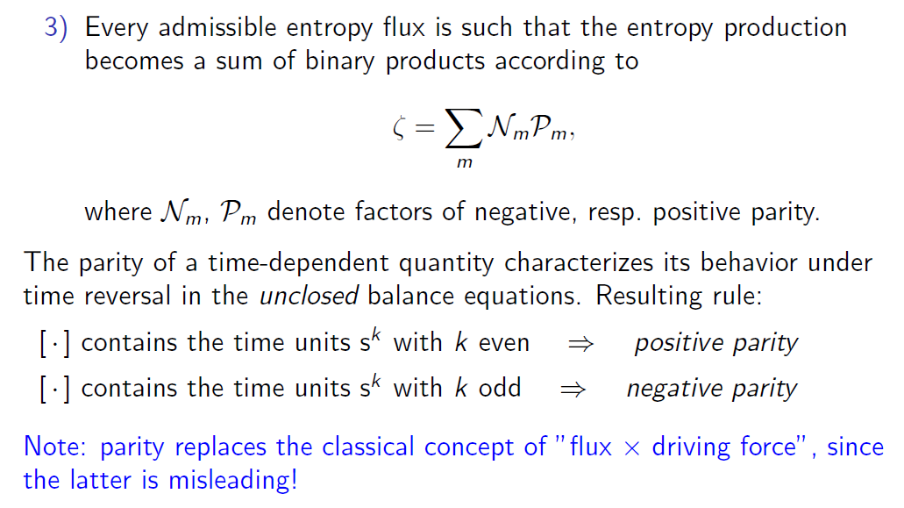
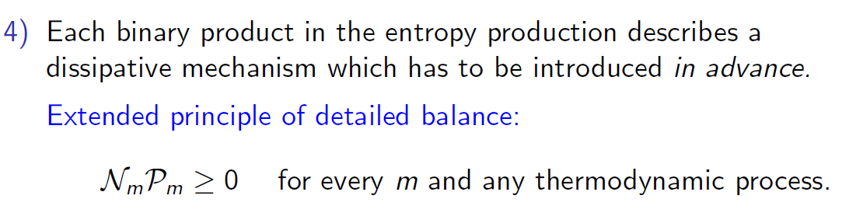

The Entropy Principle¹
the entropy density is governed by the balance equation
Ɐ
the entropy production rate has the following structure:
strengthened form:
Ɐ
Ɐ
variables: the entropy density is a function of
link to classical thermodynamics:

Slide 24
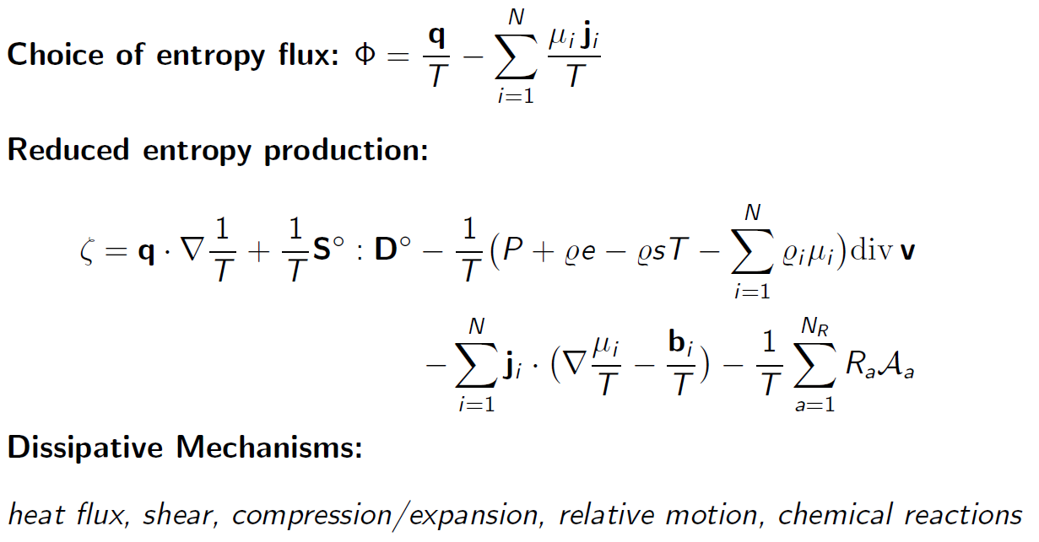
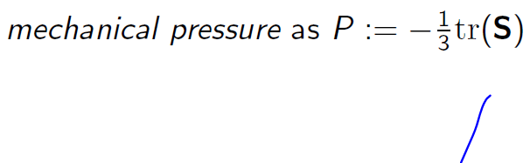
The Entropy Production Rate
entropy production
dynamic pressure π
rate of volume change
coldness
rate of strain
heat flux
shear stress
mechanical pressure
affinities
diffusion fluxes
chem.
potential over T
individual body
forces
molar reaction rates

Slide 25
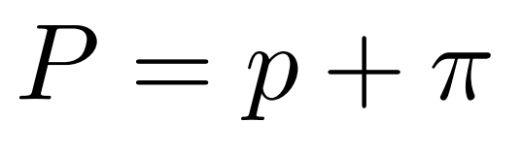
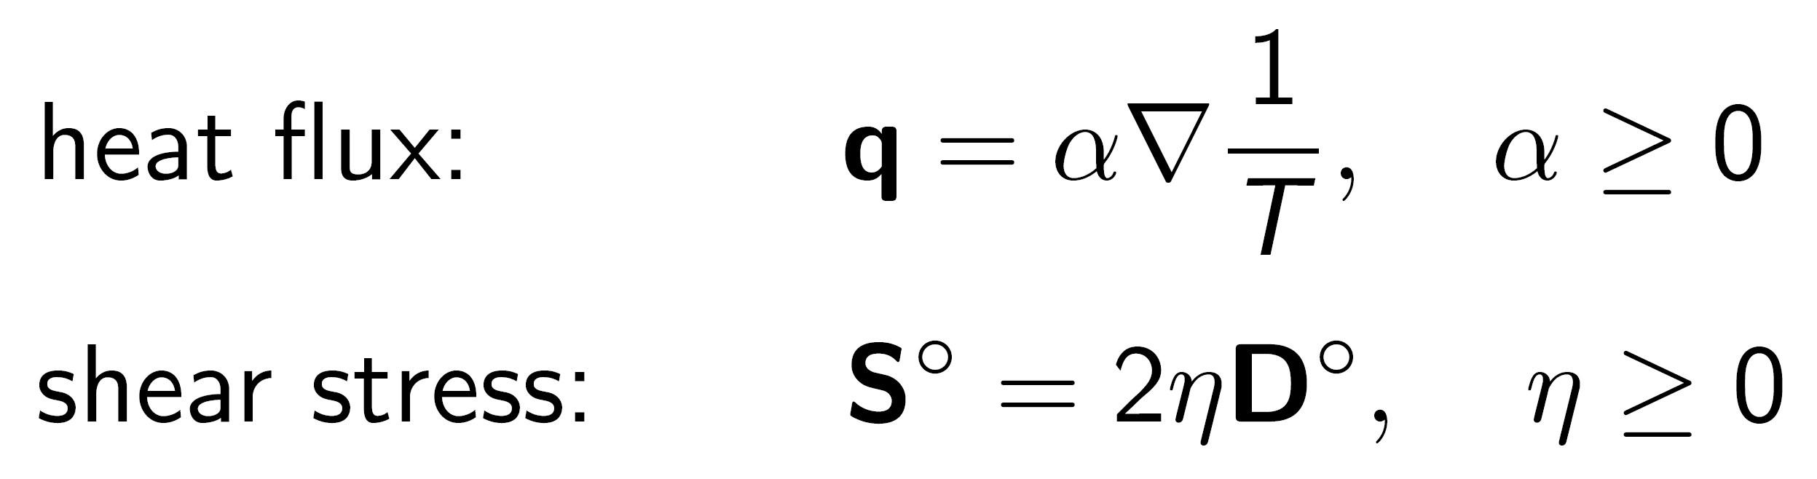
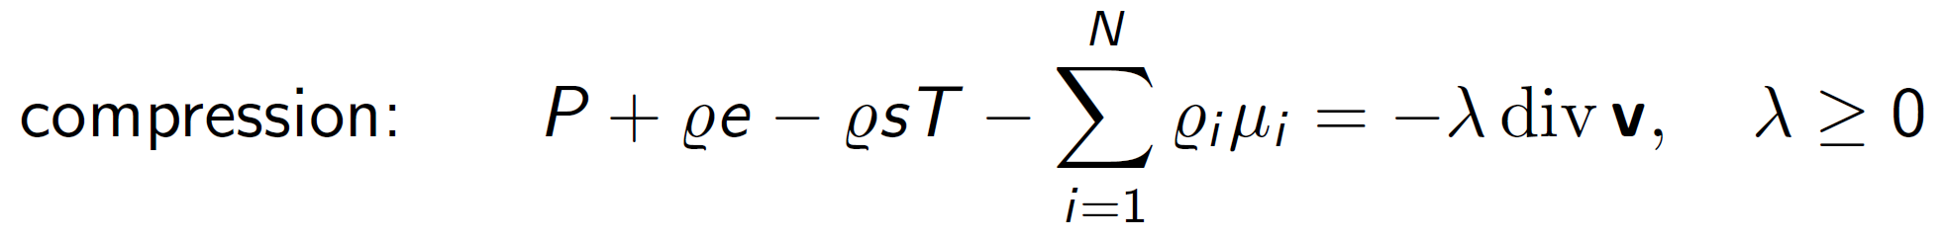







The Entropy Production Rate
sharpened 2nd law
$$≥0 !$$
$$≥0 !$$
$$≤0 !$$
$$≤0 !$$
$$≤0 !$$

Slide 26








Closure for Chemical Reactions
entropy production of
chemical reaction a:
$$≥0 !$$
reaction often run far away from equilibrium ► nonlinear closure!
has the same sign as:
Marcelin, Kohnstamm
De Donder

Slide 27





Closure for Multicomponent Diffusion Fluxes
entropy production of multicomponent diffusion:
$$≥0 !$$
Fick-Onsager:
Maxwell-Stefan:
mechanical view
to diffusion:
friction forces
=
thermodynamic driving forces

Slide 28



Closure for Multicomponent Diffusion Fluxes
entropy production of multicomponent diffusion:
$$≥0 !$$
Fick-Onsager:
Maxwell-Stefan:
Bothe-Druet:
Theorem: all three variants are equivalent !
Bothe, Druet, Int. J. Eng. Science 184:103818 (2023)

Slide 29


Duncan-Toor Experiment*
Classical experiment on cross-diffusion (in modern form):
initial
composition:
H₂ = 0.5
N₂ = 0.5
CO₂ = 0.0
initial
composition:
H₂ = 0.0
N₂ = 0.5
CO₂ = 0.5
Exp: Veltzke, Kiewidt, Thöming, AIChE Journal 61 (2015)
Sim: Weber, Bothe, AIChE Journal 62, 2929-2946 (2016)
*) J.B. Duncan, H.L. Toor: An experimental study of three component gas diffusion, AIChE Journal 8, 38-41 (1962).

Slide 30
Contents
I – Introduction
Continuum thermodynamical description of
II – Fluid Systems
III – Clean Fluid Interfaces
IV – Actual Fluid Interfaces

Slide 31





Modelling Two-Phase Fluid Systems
sharp interface framework
discontinuous field variables
jump conditions at interfaces
two-phase integral balance equations

Slide 32


Standard Model for Mass Transfer
bulk
incompressible
Navier-Stokes equations
species equations
interface
kinematic BC & no-slip
momentum jump condition
species jump conditions
is this jump condition exact?
[$φ$]$=φ^{+}−φ^{−}$

Slide 33



Mass Transfer Jump Condition
complete interface species balance:
interface species balance in non-dimensional form:
mass fractions
for oxygen transfer at technical bubbles: prefactor ≈ 0.02
volume change
only possibe
with the full
jump condition!
Bothe, Fleckenstein, Chem. Eng. Science 101 (2013)
Fleckenstein, Bothe, JCP 301 (2015)

Slide 34
Standard Model for Mass Transfer
bulk
incompressible
Navier-Stokes equations
species equations
interface
kinematic BC & no-slip
momentum jump condition
species jump conditions
is this jump condition exact?

Slide 35

Neglect Mass Transfer Entropy Production
standard assumption: local chemcial equilibrium at the interface :
model for chemical potentials:
activity
pressure influence:
d_{B}
h_{min}
Eo
Mo
Re
Sc
Pe
1.44 mm
1.8 μm
5
10⁻⁵
60
500
30.000
note:
depends (in particular) on local curvature !
Henry coefficient is NOT a constant !
Weber, Marschall, Bothe, IJHMT 104 (2017)
Weiner, Bothe, JCP 347 (2017)
Schwarzmeier et al. CPC 308:109460 (2025)

Slide 36
Contents
I – Introduction
Continuum thermodynamical description of
II – Fluid Systems
III – Clean Fluid Interfaces
IV – Actual Fluid Interfaces

Slide 37



Modelling Actual Fluid Interfaces
actual fluid interfaces are contaminated
surfactant = surface active agent
wikibrief.org/wiki/Monolayer
Interfacial concentration
http://www.bubbleology.com
surface equation of state:
surface tension gradients induce Marangoni stress
surface coverage hinders mass transfer

Slide 38




























Mass Transfer into Surfactant Solutions
CO₂ bubbles dissolving in surfactant solutions
t = 0.0 s
0.2 s
0.4 s
0.6 s
0.8 s
1.0 s
1.2 s
Clean water
σ = 72 mN/m
1-pentanol
3.2 mol/m³
σ = 68 mN/m
1-octanol
0.097 mol/m³
σ = 68 mN/m
Triton X-100
0.5 mmol/m³
σ = 67 mN/m
A. Tomiyama et al.,
Kobe University

Slide 39


Experimental Findings
A. Tomiyama et al., Kobe University

Slide 40
Effects of surface active agents on mass transfer
experimental findings
surfactant coverage leads to local mass transfer hindrance
mass transfer reduction depends on the reduction of surface tension rather than on the surfactant concentration (type of surfactant seems irrelevant)
Thermodynamically consistent continuum model of hindered mass transfer?
J. Aoki, et int., Tomiyama, Chem. Eng. Techn. 38 (2015) Y. Hori, et int., Tomiyama, Int. J. Heat Mass Trans. 136 (2019)

Slide 41







Various Interface Conceptions
$$>0$$
D. Bothe, Int. J. Eng. Sci. 179, 103731 (2022)
D. Bothe: Multi-velocity sharp-interface continuum thermodynamics of fluid systems with adsorption. arXiv:2502.00906 (2025)

Slide 42

One-sided Mass Transfer Processes in Series
mass transfer as a sequence of ad- and desorption-like processes
transfer species pass through the force field of the other (adsorbed) constituents
D. Bothe, Int. J. Eng. Sci. 179, 103731 (2022)

Slide 43


Mass Transfer Entropy Production
interfacial entropy production (zero interfacial viscosities):
D. Bothe, Int. J. Eng. Sci. 179, 103731 (2022)

Slide 44





Mass Transfer Closure
approximation:
k_{trans}
influence of surface tension
D. Bothe, Int. J. Eng. Sci. 179, 103731 (2022)

Slide 45





Mass Transfer Hindrance Model
interface free energy model: e.g. corresponding to Langmuir sorption
matches experimental findings by A. Tomiyama
Boltzmann factor
d_{B} = 5 mm
Langmuir energy barrier model, but
embedded in a consistent framework
d_{B} = 9 mm
D. Bothe, Int. J. Eng. Sci. 179, 103731 (2022)

Slide 46

Mass Transfer Hindrance Model
interface free energy model: e.g. corresponding to Langmuir sorption
Boltzmann factor
Langmuir energy barrier model, but
embedded in a consistent framework
D. Bothe, Int. J. Eng. Sci. 179, 103731 (2022)

Slide 47
Conclusions
the dynamics of transient, irreversible processes should be modelled within the framework of the entropy principle
the entropy derivatives, in particular the chemical potentials, amplify changes in composition to become changes of the entropy
the chemical potentials depend on local composition, temperature and – strongly – on the local pressure
► proper coupling between mechanics and chemistry required ! ► make sure to compute thermodynamic pressure in CFD !
The modeling for fluid interfaces can be adapted to solid surfaces
for charged constituents (ions), the Coulomb forces due to the (intrinsic) electric field have to be accounted for – within a consistent framework such as with Maxwell-Stefan multicomponent diffusion

Slide 48



Acknowledgment
joint work with:
S. Fleckenstein, M. Fricke, T. Maric, M. Schwarzmeier, P. Weber, A. Weiner
W. Dreyer^{ꝉ}, P.-E. Druet, M. Schlüter, A. Tomiyama

Slide 49
Thank You
for Your kind attention !

