Slide 1
The Interplay of Nanoconfinement and pH from the Perspective of a Dye-Reporter Molecule
Robert Brilmayer, Martin Brodrecht, Christoph Kaiser, Hergen Breitzke, Bharti Kumari, Josef Wachtveitl, Gerd Buntkowsky, and Annette Andrieu-Brunsen
https://doi.org/10.1002/cnma.202000423
Public Data

Slide 2
Scheme 1
a)
b)
25 °C, 24 h,
Toluol
MPT-Ph
25 °C, 24 h,
HATU, DIPEA

Slide 3
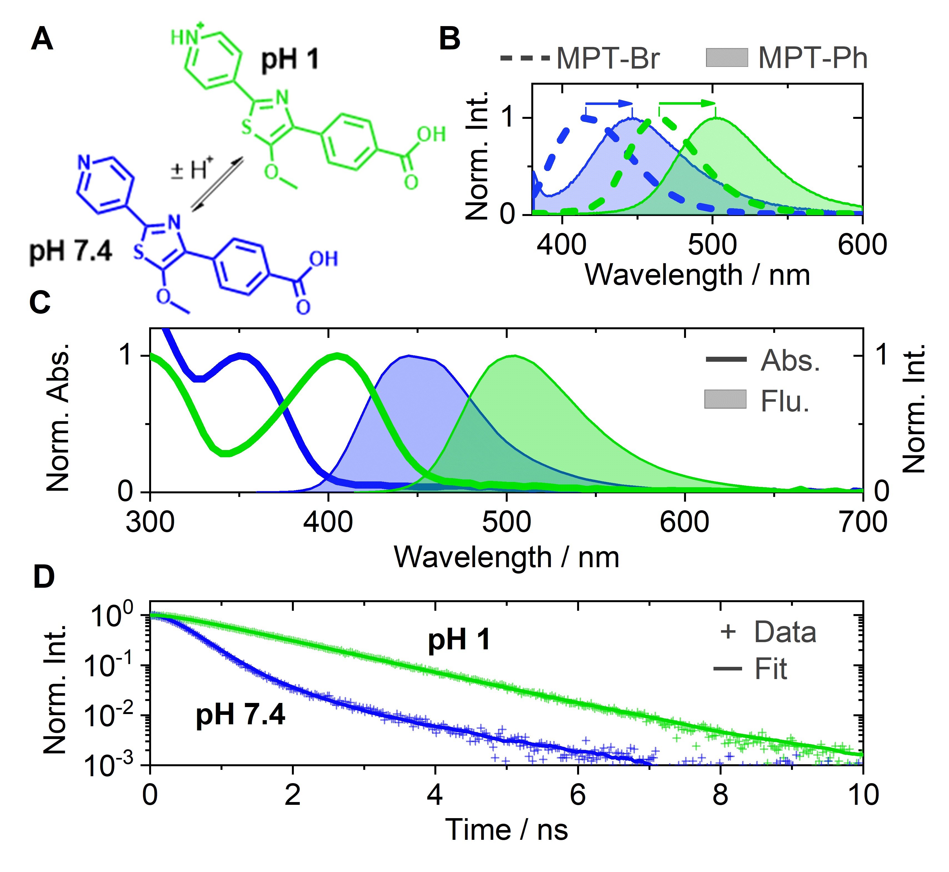
Figure 1

Slide 4
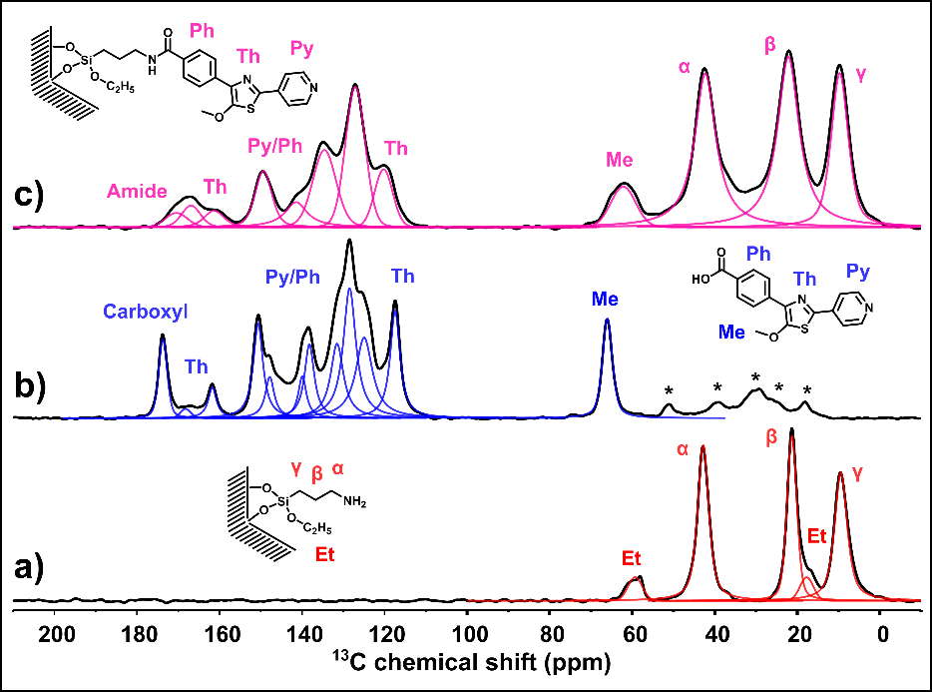
Figure 2

Slide 5
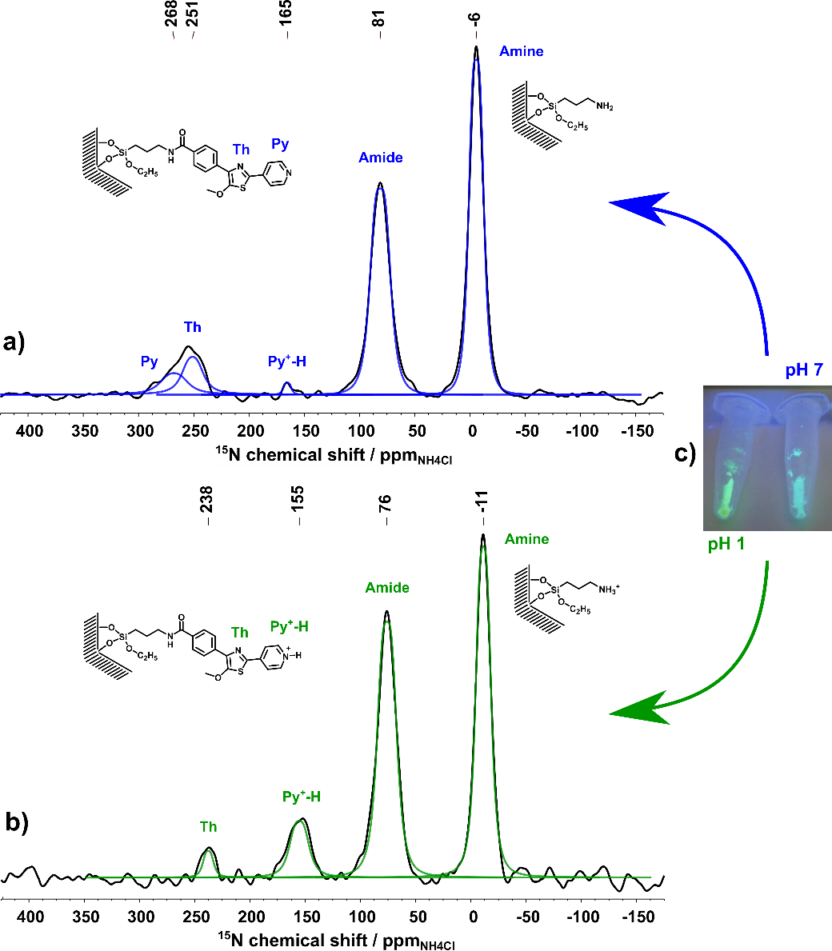
Figure 3

Slide 6
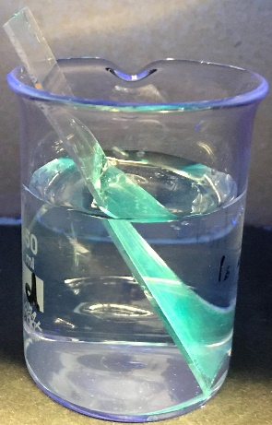
Figure 4
a)
b)
1000 nm thick;
16 nm pores
500 nm thick;
16 nm pores
200 nm thick; 8 nm pores
reference
c)
MPT-Ph
MPT-Ph-
amide
MPT-Ph-
surface

Slide 7
Figure 5
MPT-Ph
MPT-Ph-H⁺
a)
b)

Slide 8
Figure 6
MPT-Ph-
amide
a)
b)
1xPBS
0.1xPBS
MPT-Ph-
surface

Slide 9
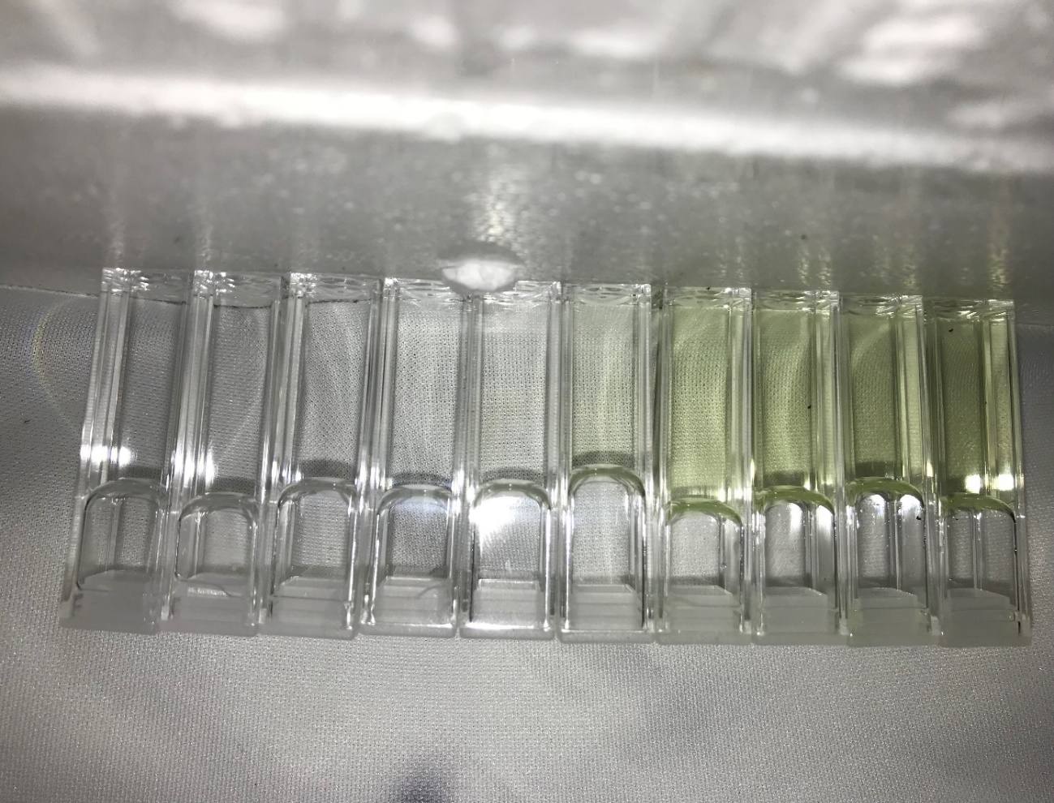
Graphical Abstract
pH

