Slide 1
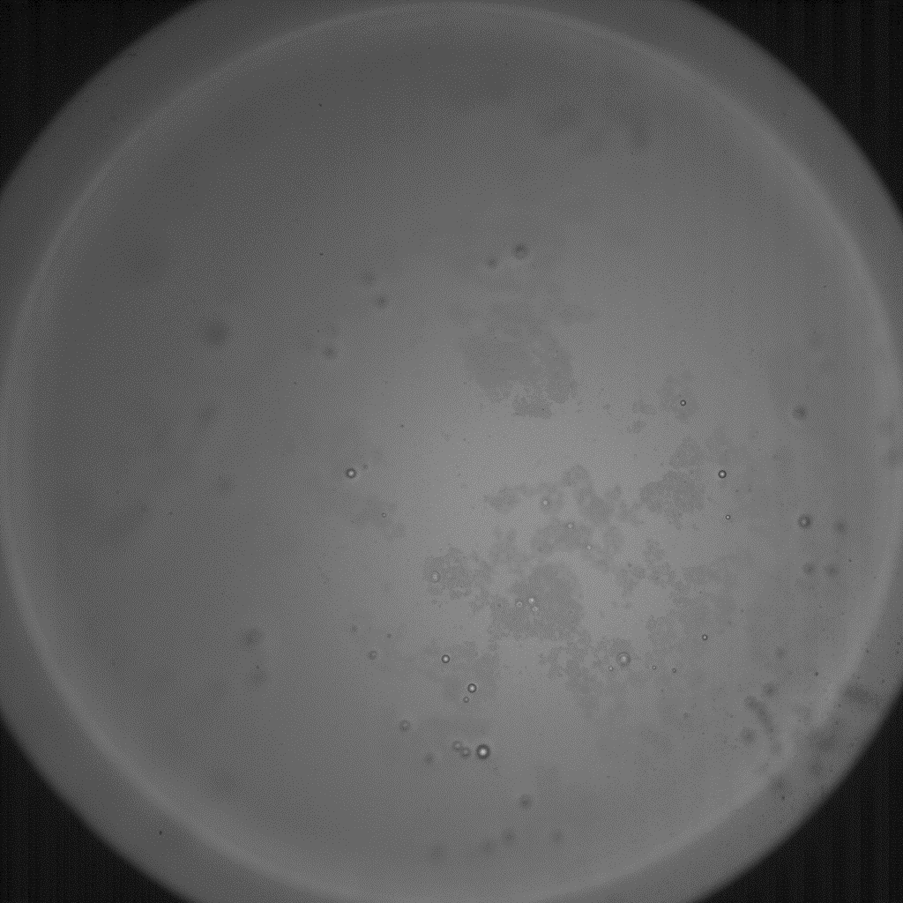
Supporting Video 1 – Presence of floating coating rafts on the sessile mother drop surface
Video 1:
Presence of floating coating rafts on the sessile mother drop surface.
Secondary daughter drops float on the rafts as they show similar displacement as the underlying light and dark structures.
100 µm

Slide 2
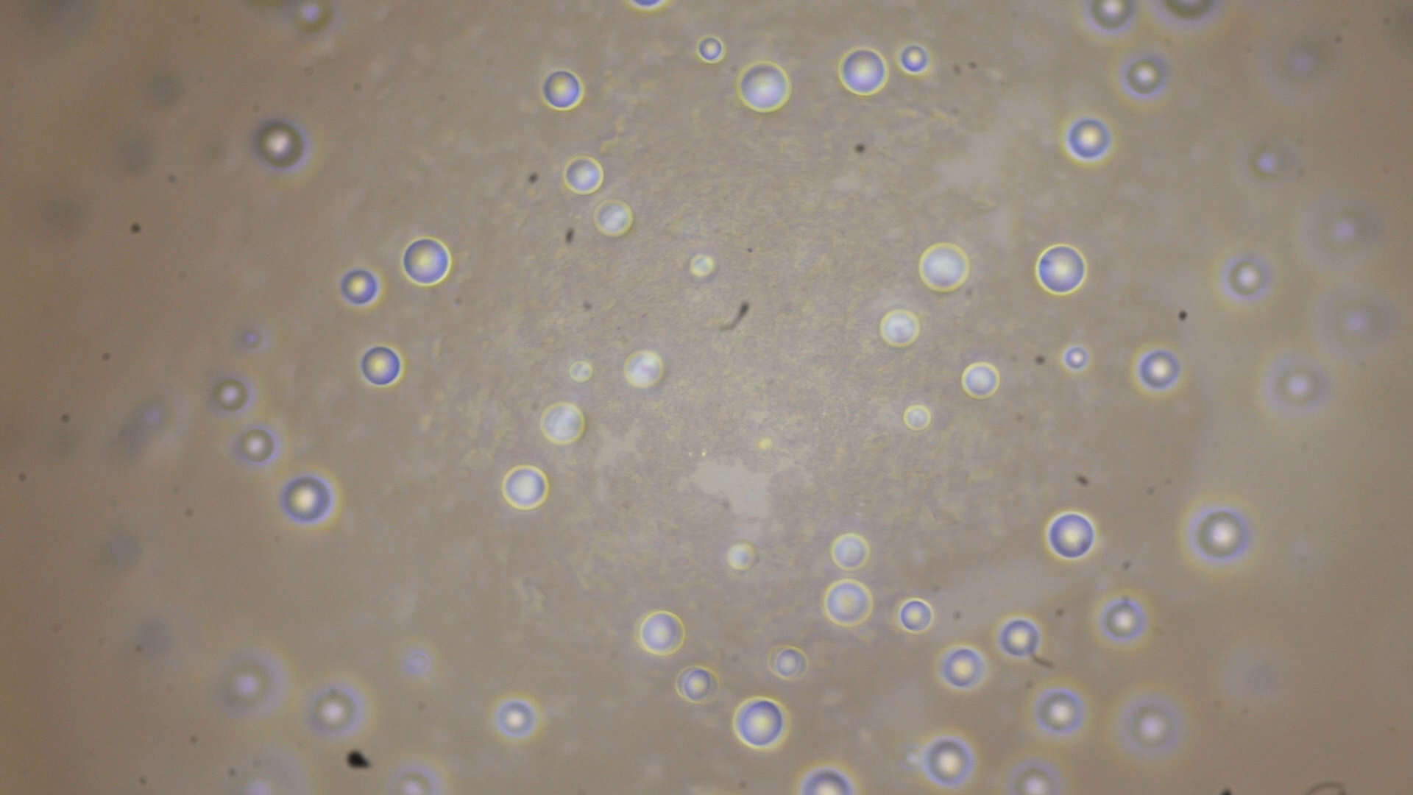
Supporting Video 2 – Nucleation and growth of daughter drops on the surface of a sessile condensate drop
Video 2:
Visible nucleation and growth of condensate drop on motherdrop surface covered with adhering superhydrophobic coating material.
20 µm

Slide 3
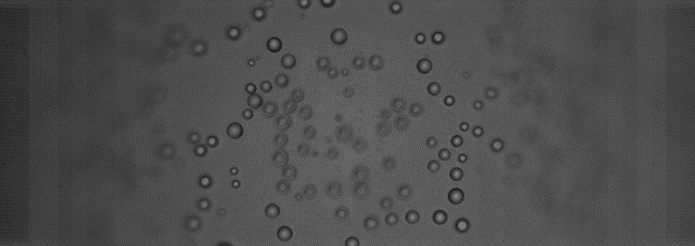
Supporting Video 3 – Coalescence-induced jumping of daughter drops on the surface of a sessile condensate drop
50 µm
20x, 50.000 FPS
Video 3: coalescence induced jumping of secondary daughter drops on the mother drop surface, indicating the adhesion of superhydrophobic coating material

Slide 4
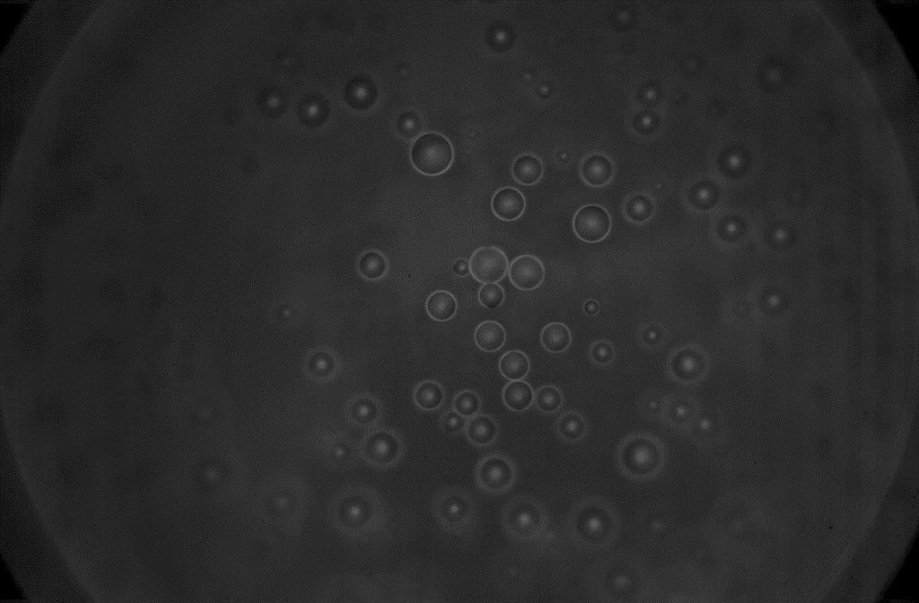
Supporting Video 4 – immersion of coalescing daughter drops into a sessile condensate drop
Video 4:
Coalescence of sessile daughter drops on mother drop surface (red circle) and subsequent launch of neighboring daughter drop.
Note that no jump is detected for the drops involved in the initial coalescence event, so immersion into the mother drop is assumed.
50 µm
50x, 20.000 FPS

Slide 5
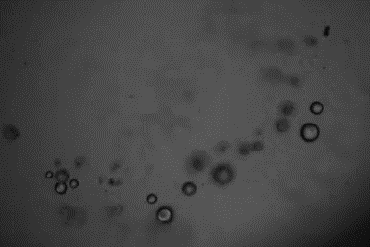
Supporting Video 5 – Ejection of sessile daughter drops in the vicinity of a coalescence event
Video 5:
Coalescence of sessile daughter drops on mother drop surface (red circle) and subsequent launch of 3 neighboring daughter drop.
20 µm
36x, 100.000 FPS, 759 µs

Slide 6
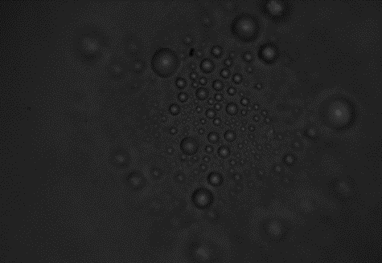
Supporting Video 6 – Ejection of sessile daughter drops in the vicinity of a coalescence event
Video 6:
Coalescence of sessile daughter drops on mother drop surface (red) and subsequent launch of 4 neighboring individual daughter drops (white), coalescence induced jumps of neighboring daughter drops (black) and triggered daughter drop coalescence and immersion into mother drop (orange).
50 µm
36x, 50.000 FPS, 1208 µs

Slide 7
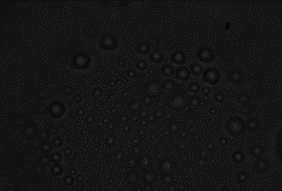
Supporting Video 7 – Ejection of sessile daughter drops in the vicinity of a coalescence event
Video 7:
Coalescence of sessile daughter drops on mother drop surface (red) and subsequent launch of multiple neighboring individual daughter drops (white), coalescence induced jumps of neighboring daughter drops (black) and triggered daughter drop coalescence and immersion into mother drop (orange).
30 µm
36x, 81.000 FPS, 800 µs

