Slide 1
Mesoporous Coatings with Simultaneous Light-Triggered Transition of Water Imbibition and Droplet Coalescence
Adnan Khalil, Peyman Rostami, Günter K. Auernhammer, and Annette Andrieu-Brunsen
https://doi.org/10.1002/admi.202100252
Public Data

Slide 2
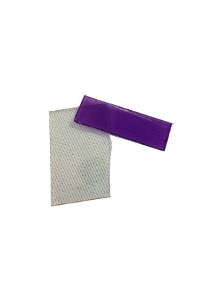
Figure 1
Dark, RT, Vis
UV

Slide 3
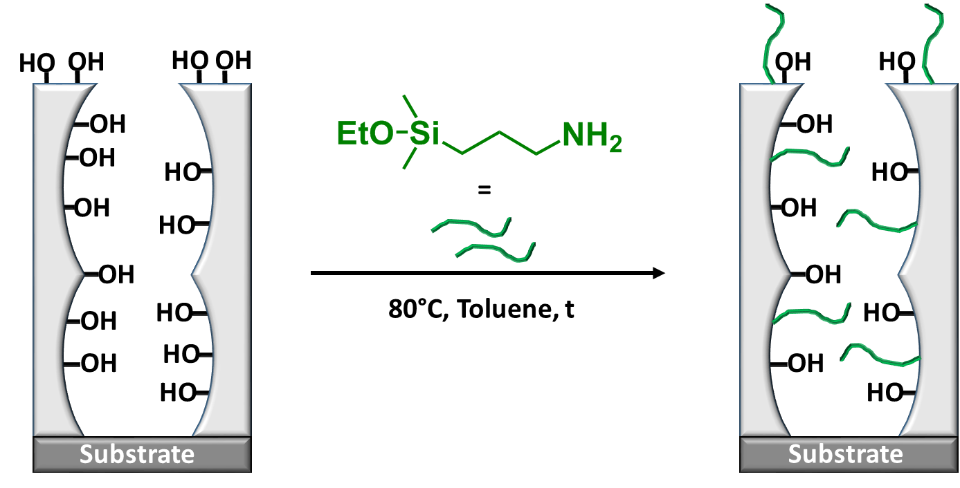
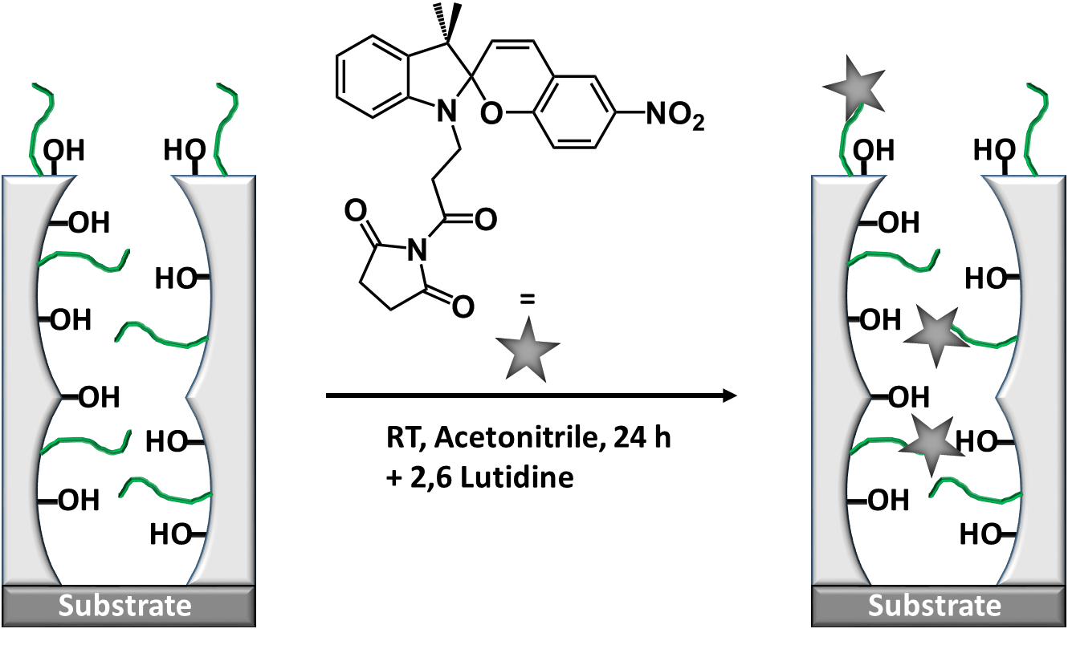
Figure 2
a)
b)
1.
2.
c)
d)

Slide 4
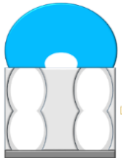


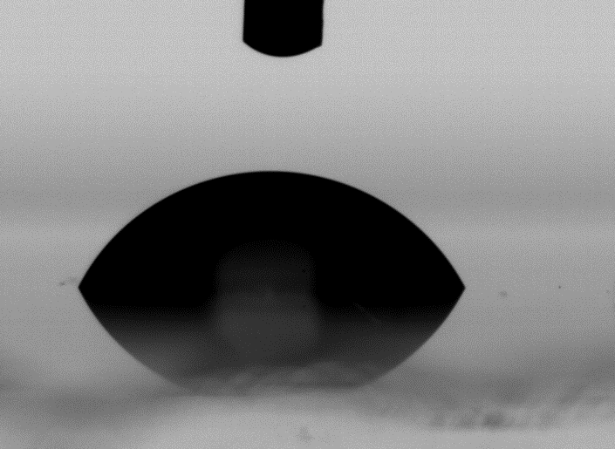

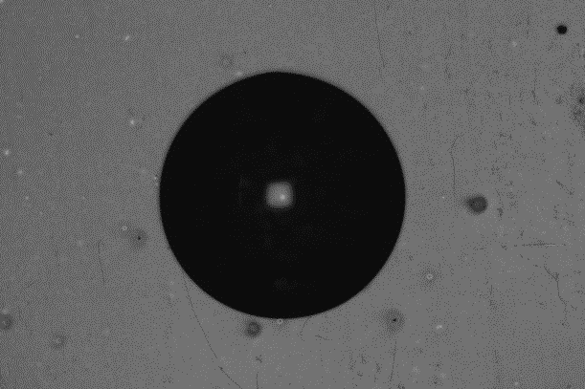
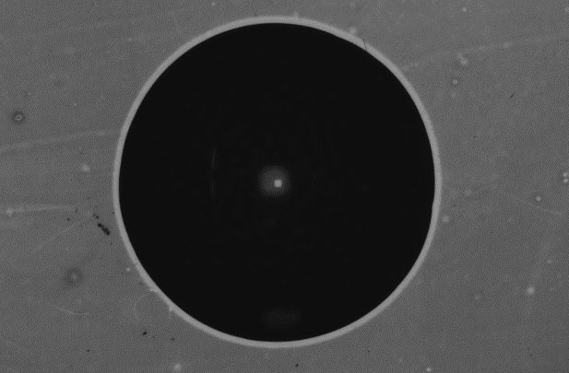

Figure 3
a)
b)

Slide 5
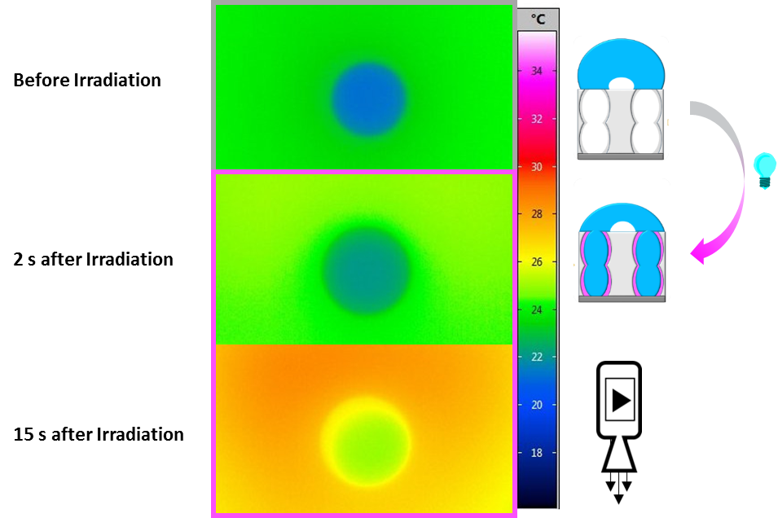
Figure 4

Slide 6
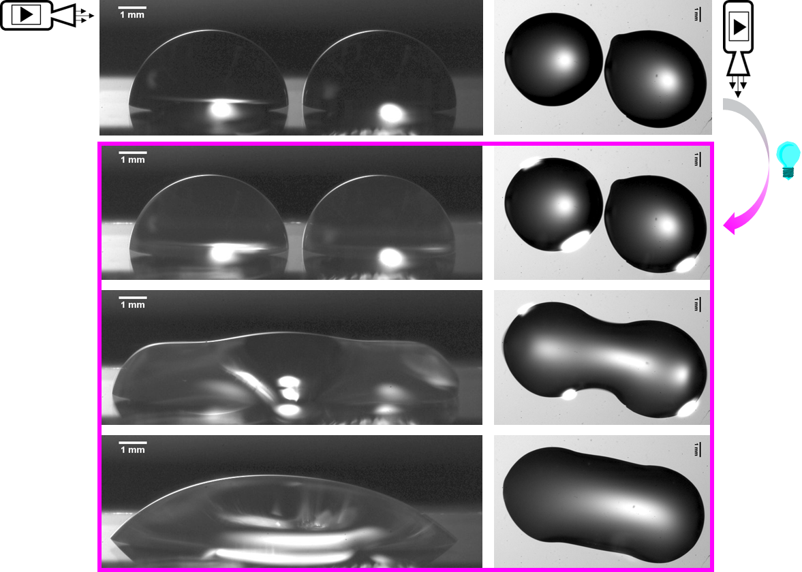
Figure 5

